Slide 1
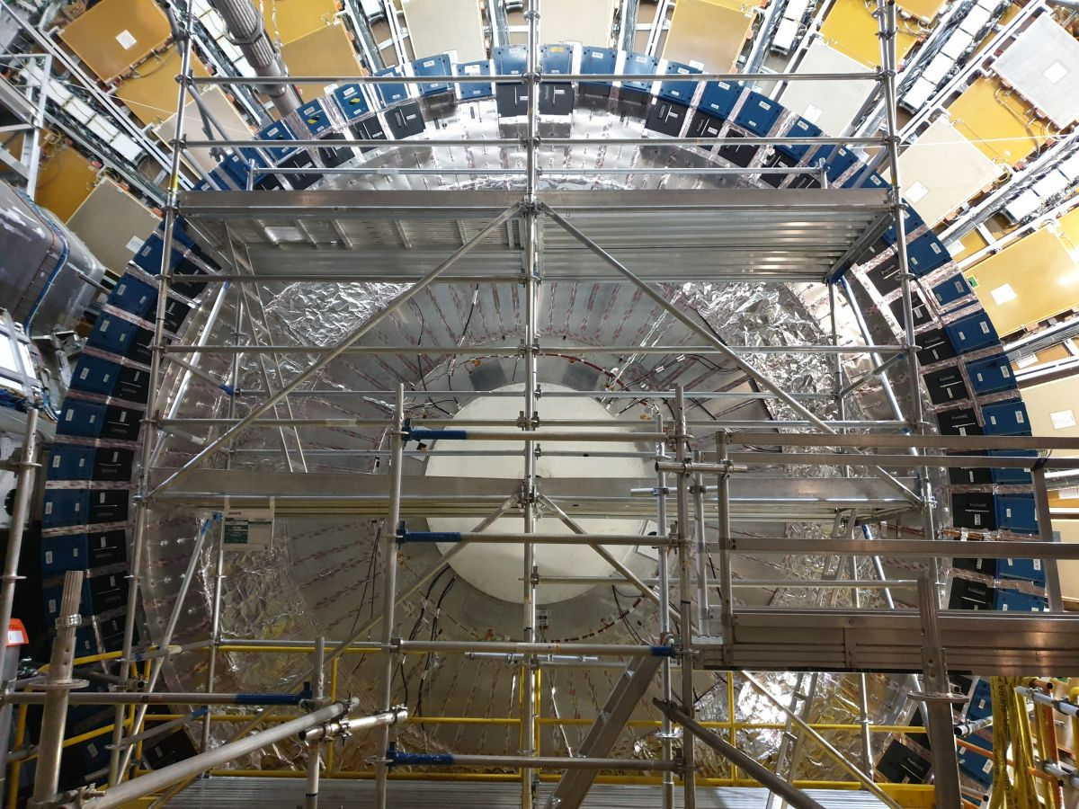


CIS Tech Update
Chicago Weekly Meeting, 21 June 2021
Elias Oakes and Mikel Zemborain

Slide 2
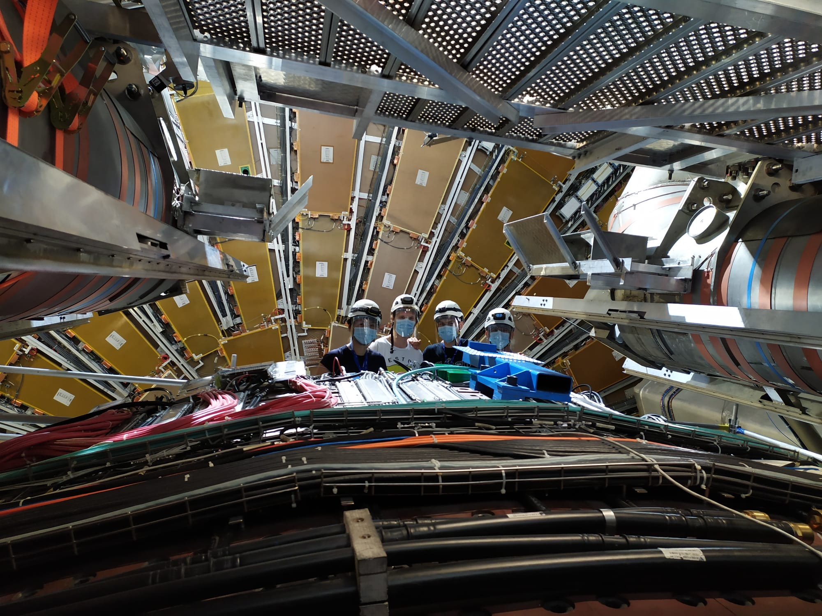
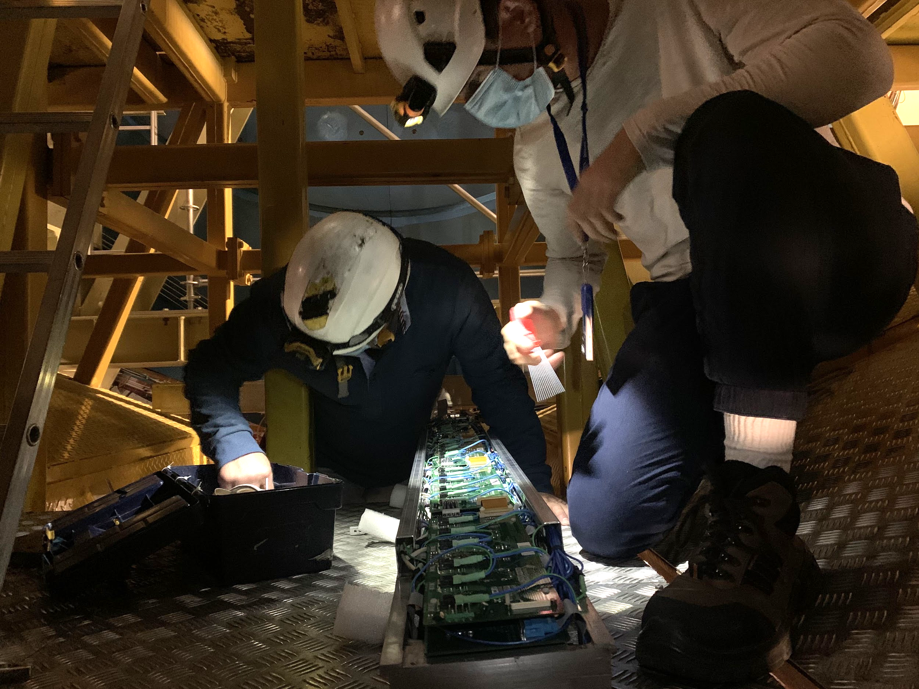
Outline
TileCal electronics
Detector maintenance
Testing and hardware failures
Recent progress
Detector status
Cooling valves installation
Motivation
Installation procedure
Progress
Charge Injection System (CIS)
CIS and recalibration overview
March, April, June CIS updates

Slide 3
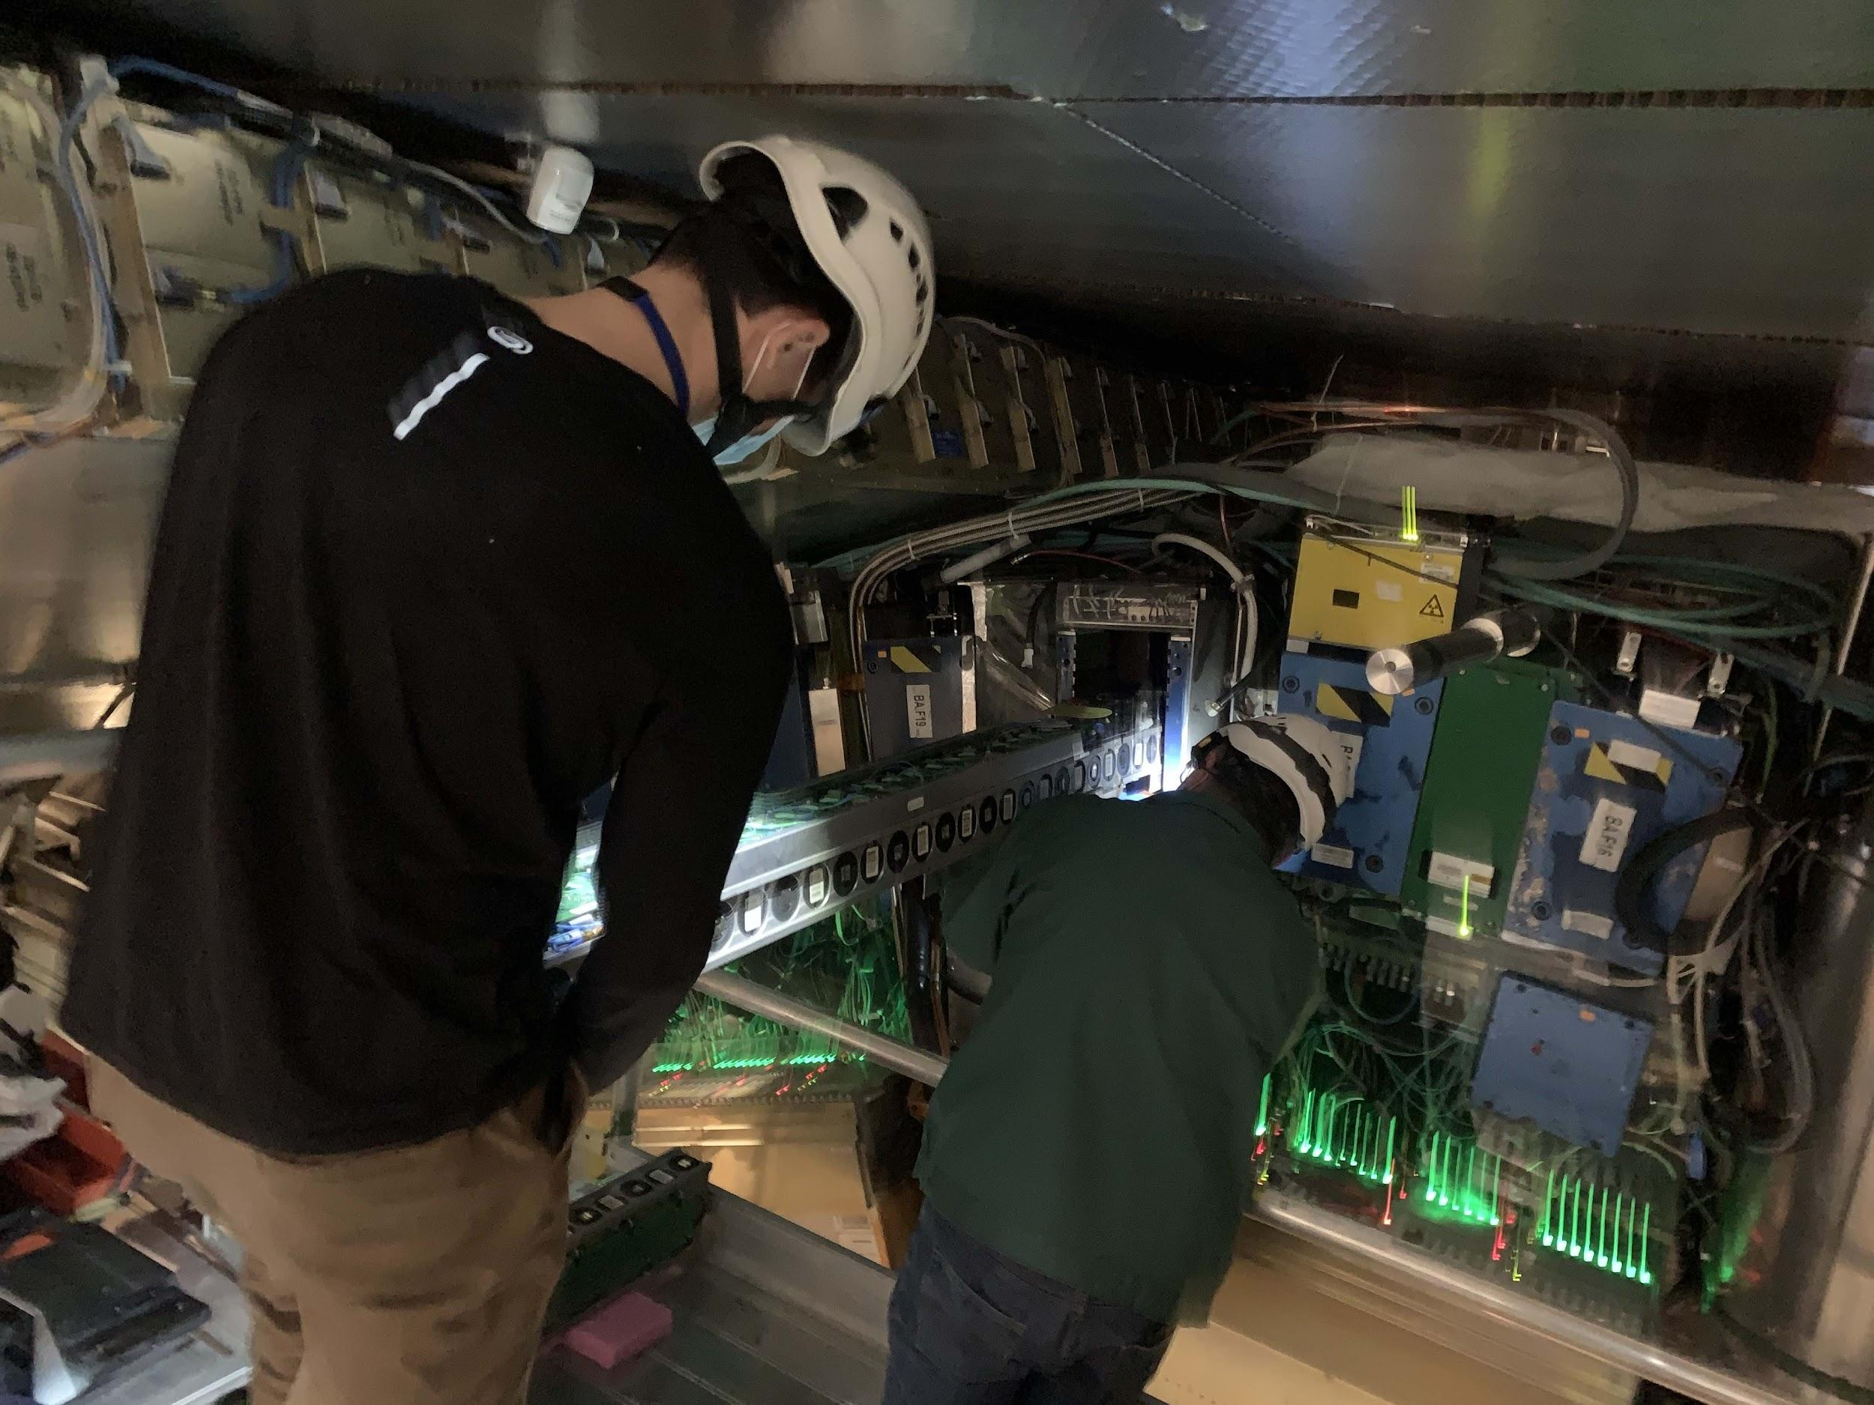
TileCal Electronics

Slide 4
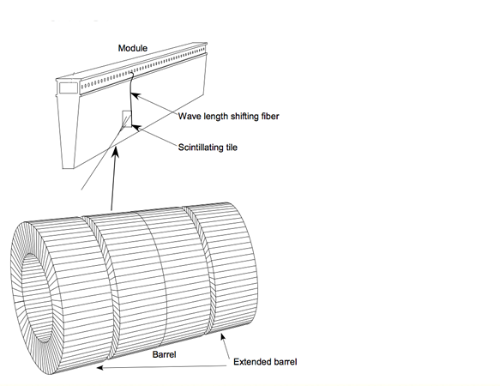
ATLAS Tile Calorimeter
4 partitions (barrels)
64 modules per partition
Modules house scintillating tiles and drawers with front-end electronics
EBA LBA LBC EBC

Slide 5
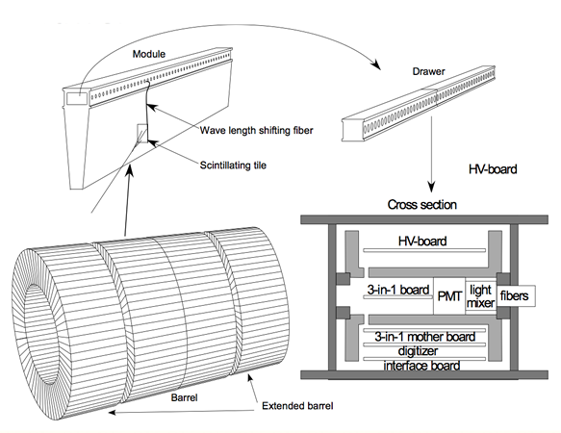
Measuring physics signals
Scintillating tiles emit photons when excited
Fibers deliver light to PMTs
48 channels per drawer
EBA LBA LBC EBC

Slide 6
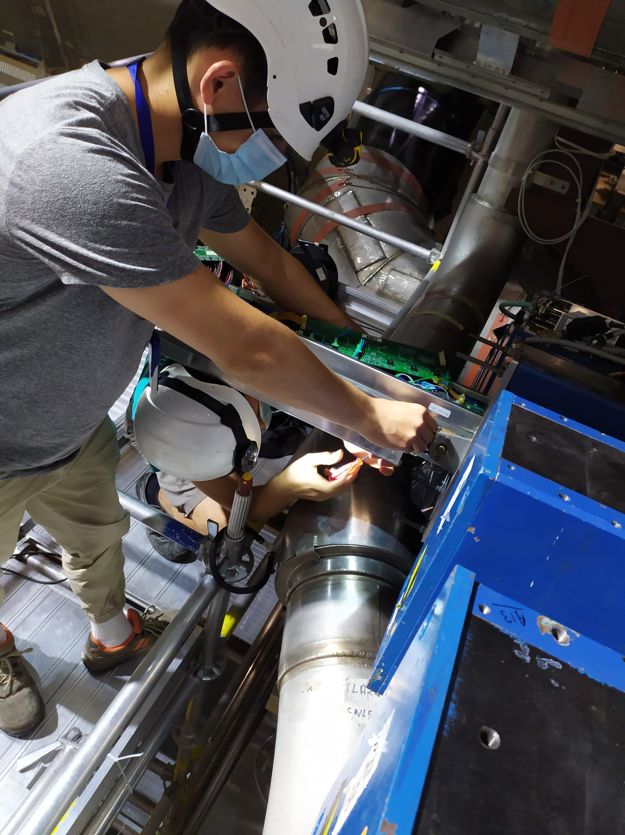
Detector maintenance

Slide 7
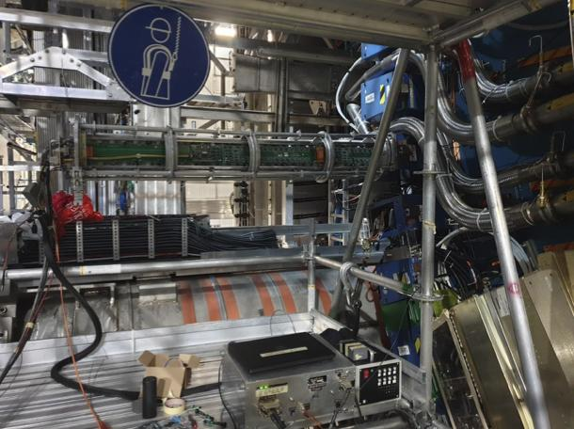
Testing with MobiDICK
Emulates control room electronics
Internal communication
Charge injection
Integrator
Trigger tests
High voltage and LED tests
Tests before maintenance
Confirm DQ issues
Narrow down origins
Tests during and after maintenance
Ensure initial issue addressed
Check for new problems

Slide 8
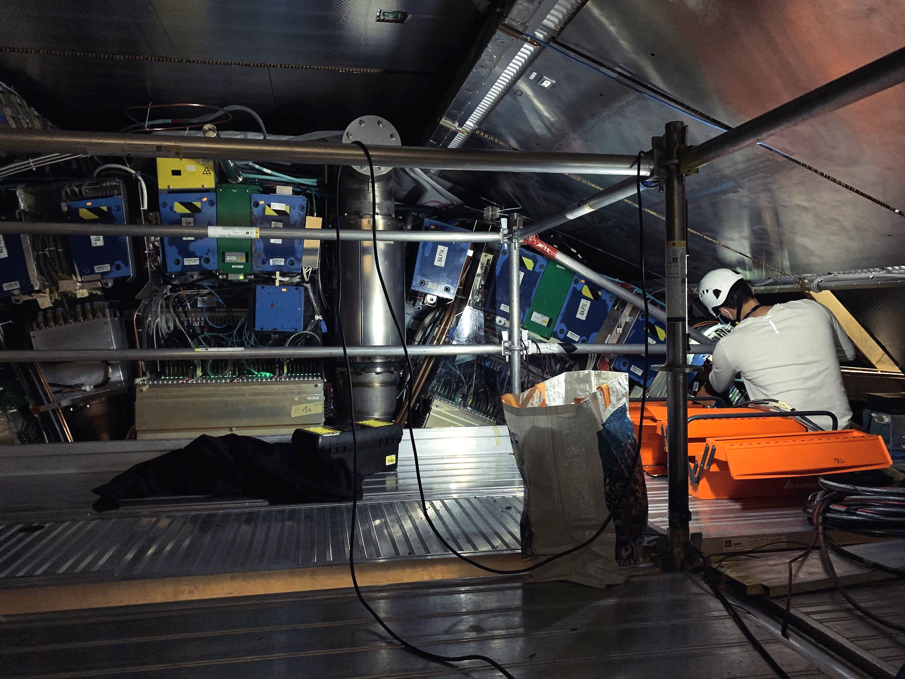
Potential Hardware Failures
3in1 cards burnout
Damaged integrator
Worn optical fibers
Damaged interface cards
Motherboard communication
Noise killer burnout
Damaged digitizers
Loose PMT HV cable connections
High voltage boards
HV opto and micro cards
Bad cable connections (noise)
Worn insulators

Slide 9
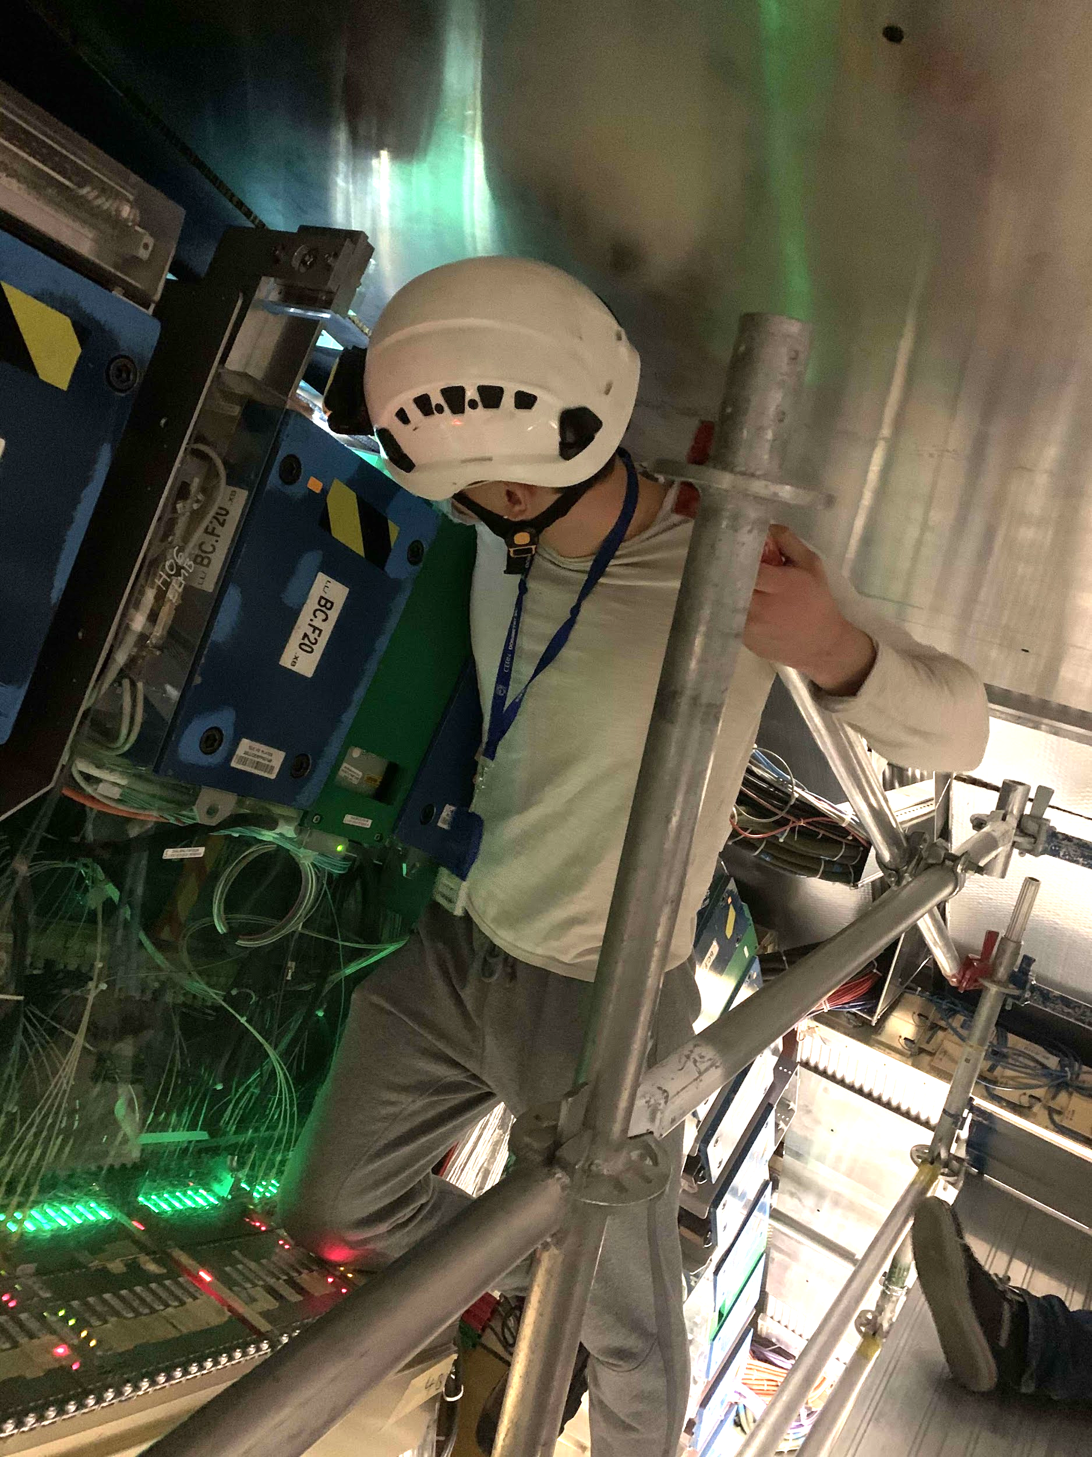
Maintenance Progress (Since March 2021)
Drawers we have maintained:
EBA 26, 44 (Total: 2)
LBA 06, 18, 54, 55, 56 (Total: 5)
LBC 06, 14, 16, 18, 37, 51, 63 (Total: 7)
EBC 03, 30, 39, 52 (Total: 4)
18 overall

Slide 10
Total Maintenance Progress (as of June 2021)
All maintained drawers:
EBA 03, 07, 08, 09, 10, 12, 16, 17, 18, 19, 20, 24, 25, 26, 27, 29, 30, 34, 35, 36, 37, 39, 40, 41, 42, 43, 44, 46, 54, 55, 56, 57, 58, 59, 61, 63 (Total: 36)
LBA 01, 05, 06, 07, 08, 10, 11, 13, 16, 17, 18, 22, 23, 36, 37, 40, 41, 42, 43, 45, 46, 49, 50, 51, 52, 53, 54, 55, 56, 57, 58, 59, 61, 62, 63 (Total: 35)
LBC 01, 02, 05, 06, 08, 09, 10, 11, 14, 16, 17, 18, 19, 21, 23, 26, 27, 28, 29, 30, 32, 34, 37, 40, 41, 43, 44, 47, 48, 49, 51, 55, 56, 57, 59, 60, 63, 64 (Total: 38)
EBC 02, 03, 04, 06, 07, 08, 09, 11, 13, 15, 16, 17, 18, 19, 21, 27, 30, 35, 38, 39, 40, 41, 42, 43, 49, 50, 52, 55, 56, 57, 58, 59, 61, 63, 64 (Total: 35)

Slide 11
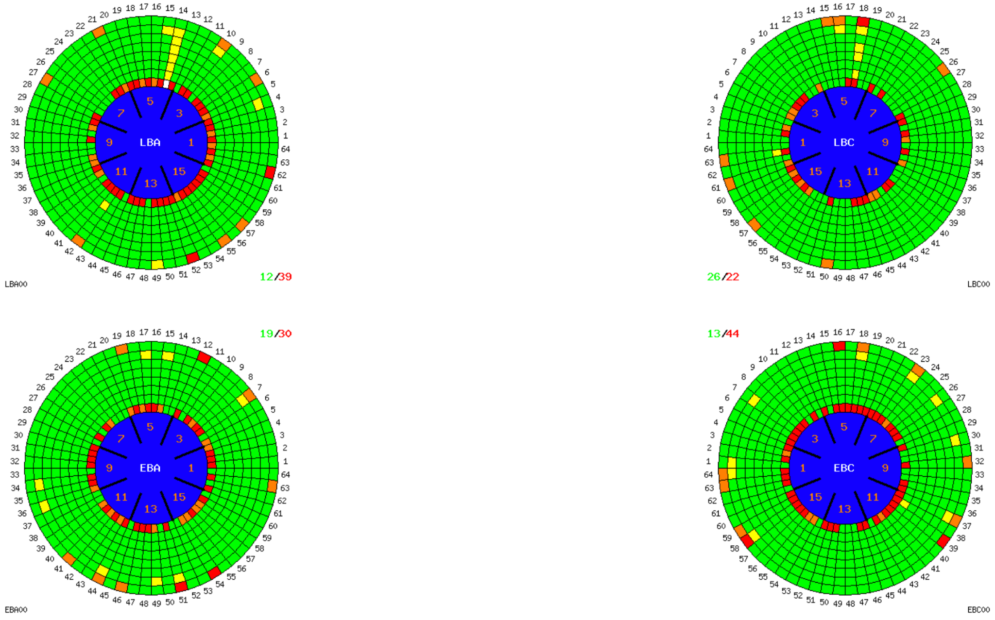
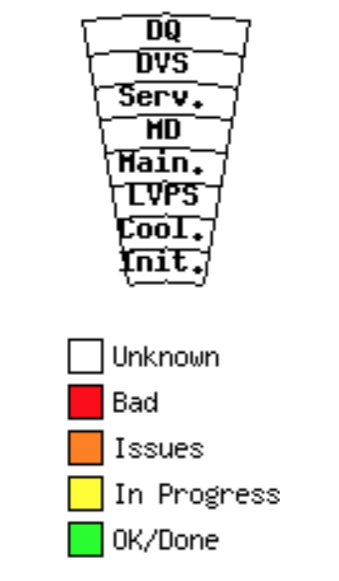

Detector Status
(really good)

Slide 12
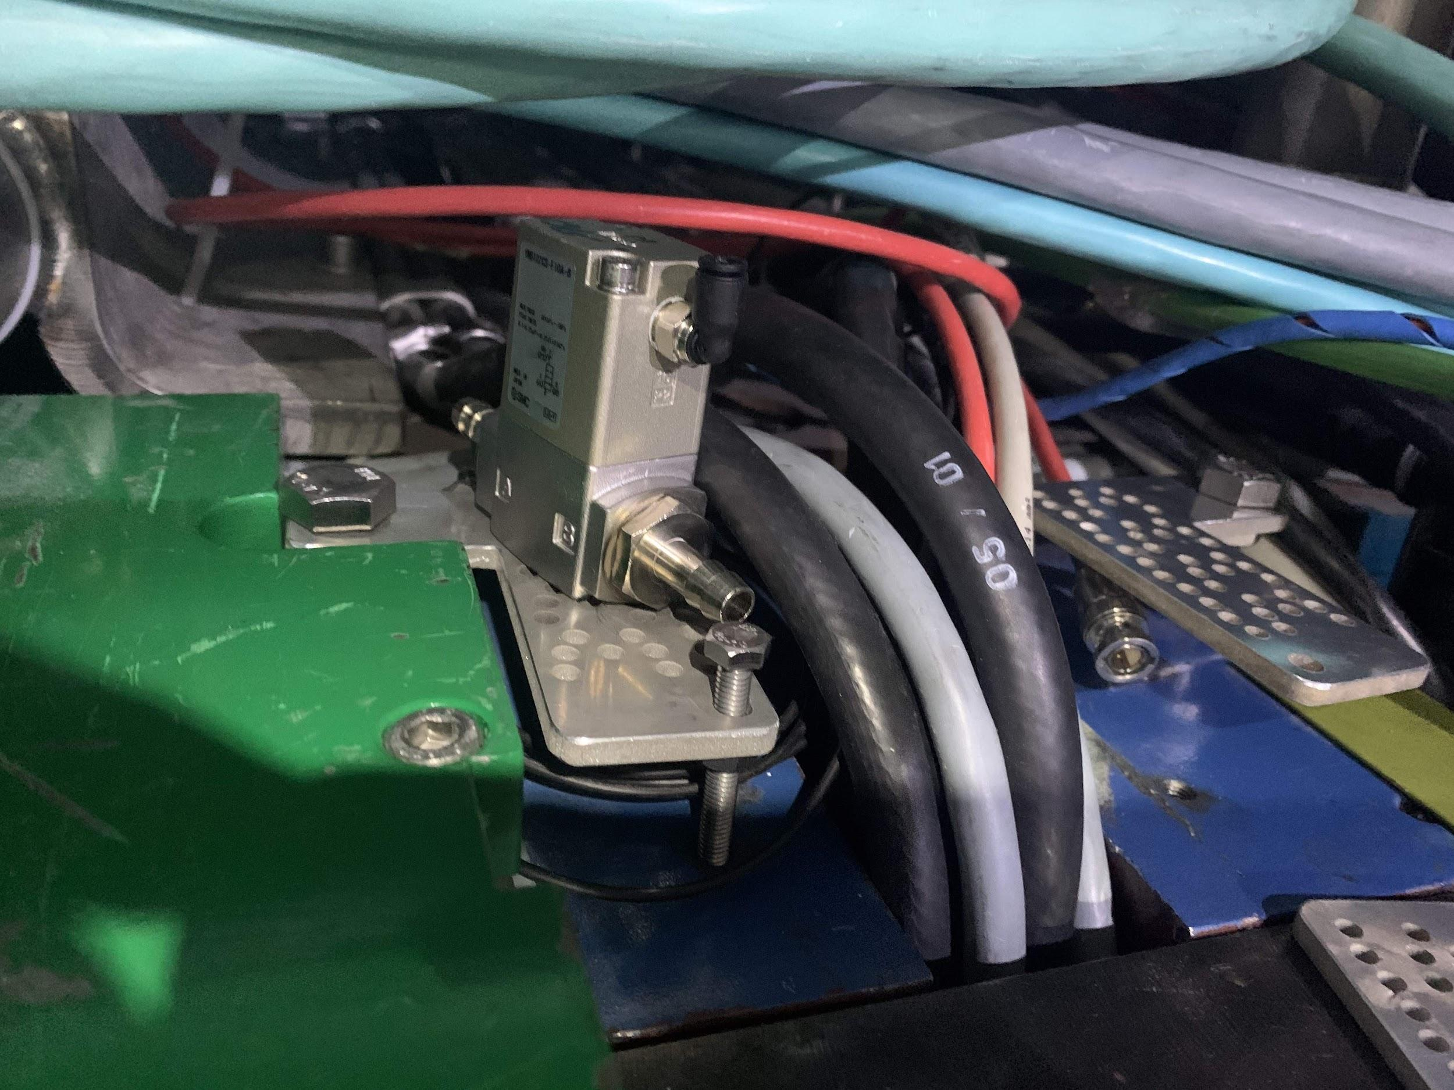
Cooling Valves Installation

Slide 13
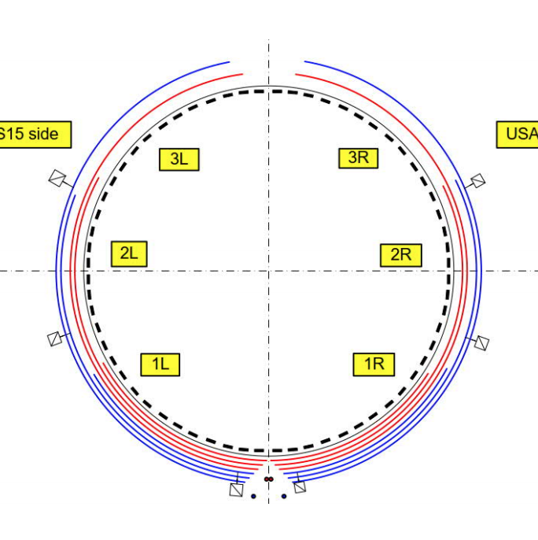
Motivation
Cooling Loop Distribution
A cooling leak in a single drawer can threaten to shut down all drawers within that cooling loop
Valves will isolate the leak to a single drawer, without needing someone to enter the detector during Run 3

Slide 14
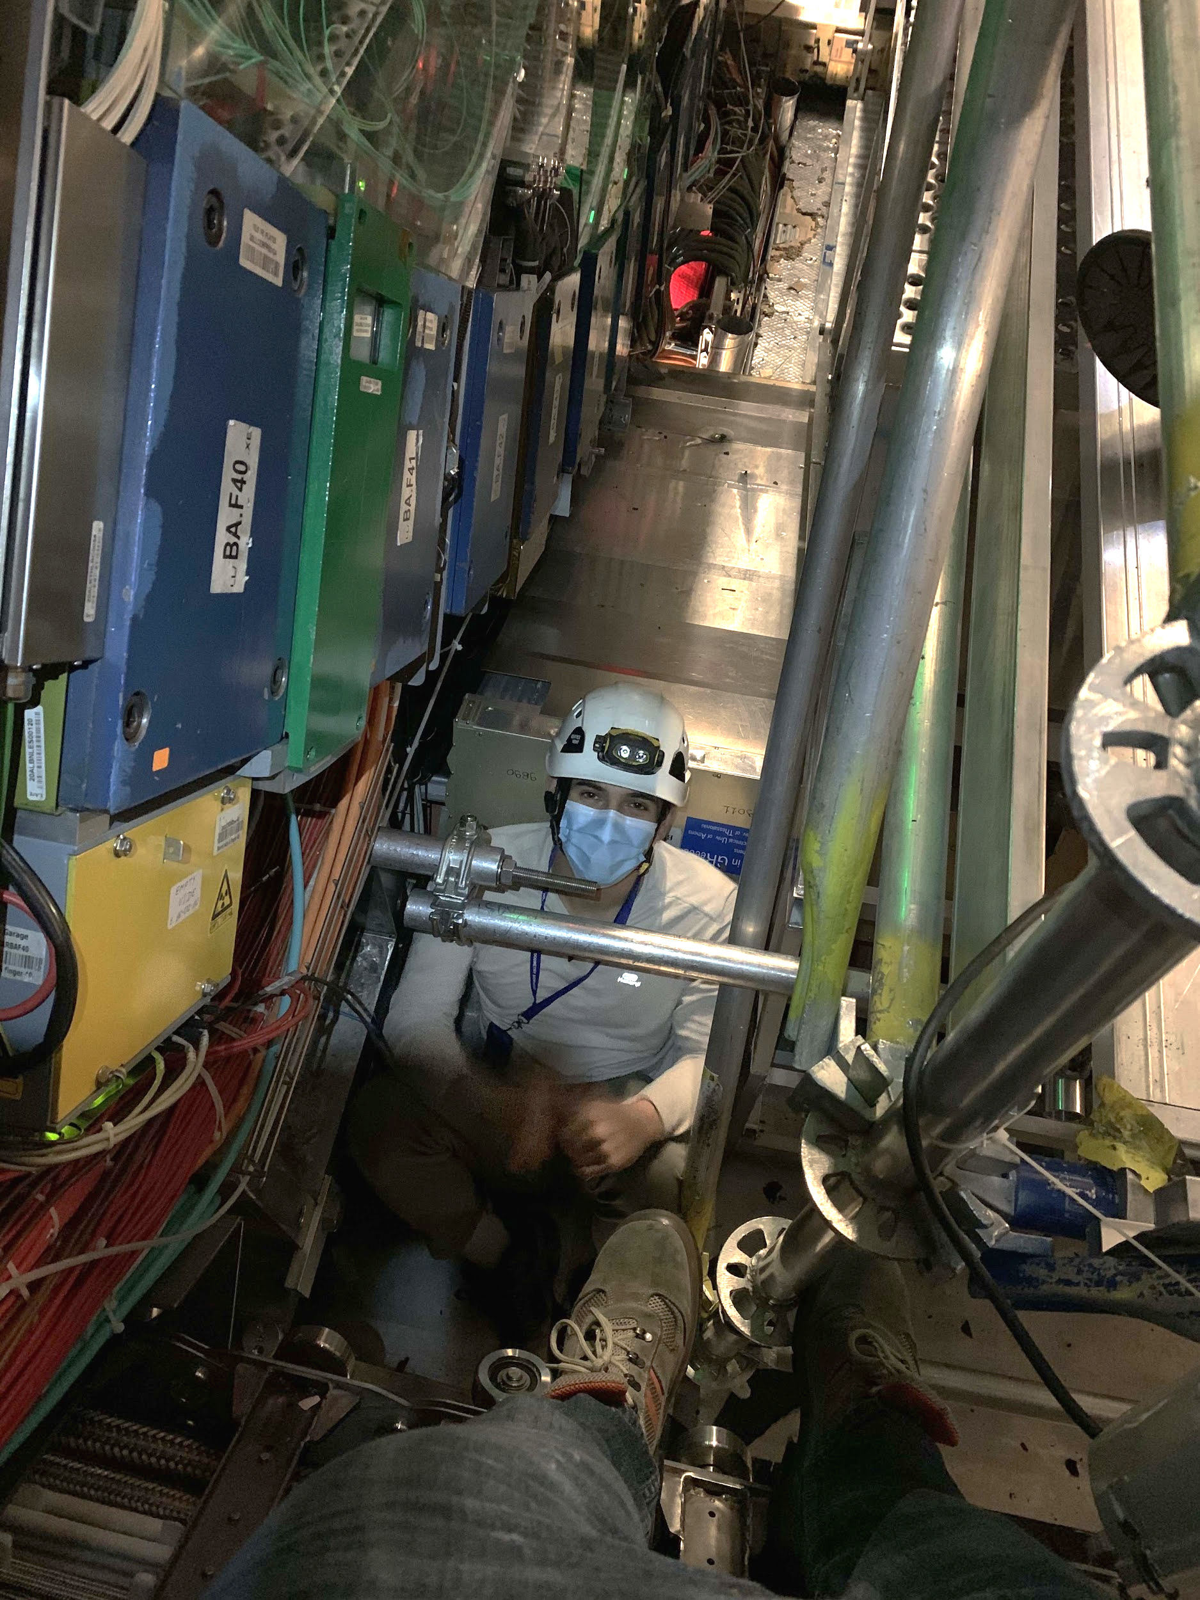
Installation Procedure
Identify drawers and appropriate cooling loop
Fit brackets with valves on accessible drawers
Need access to pipe connection
Check reasonable bending radius
Stop cooling loops, connect cooling pipes, restart loops

Slide 15
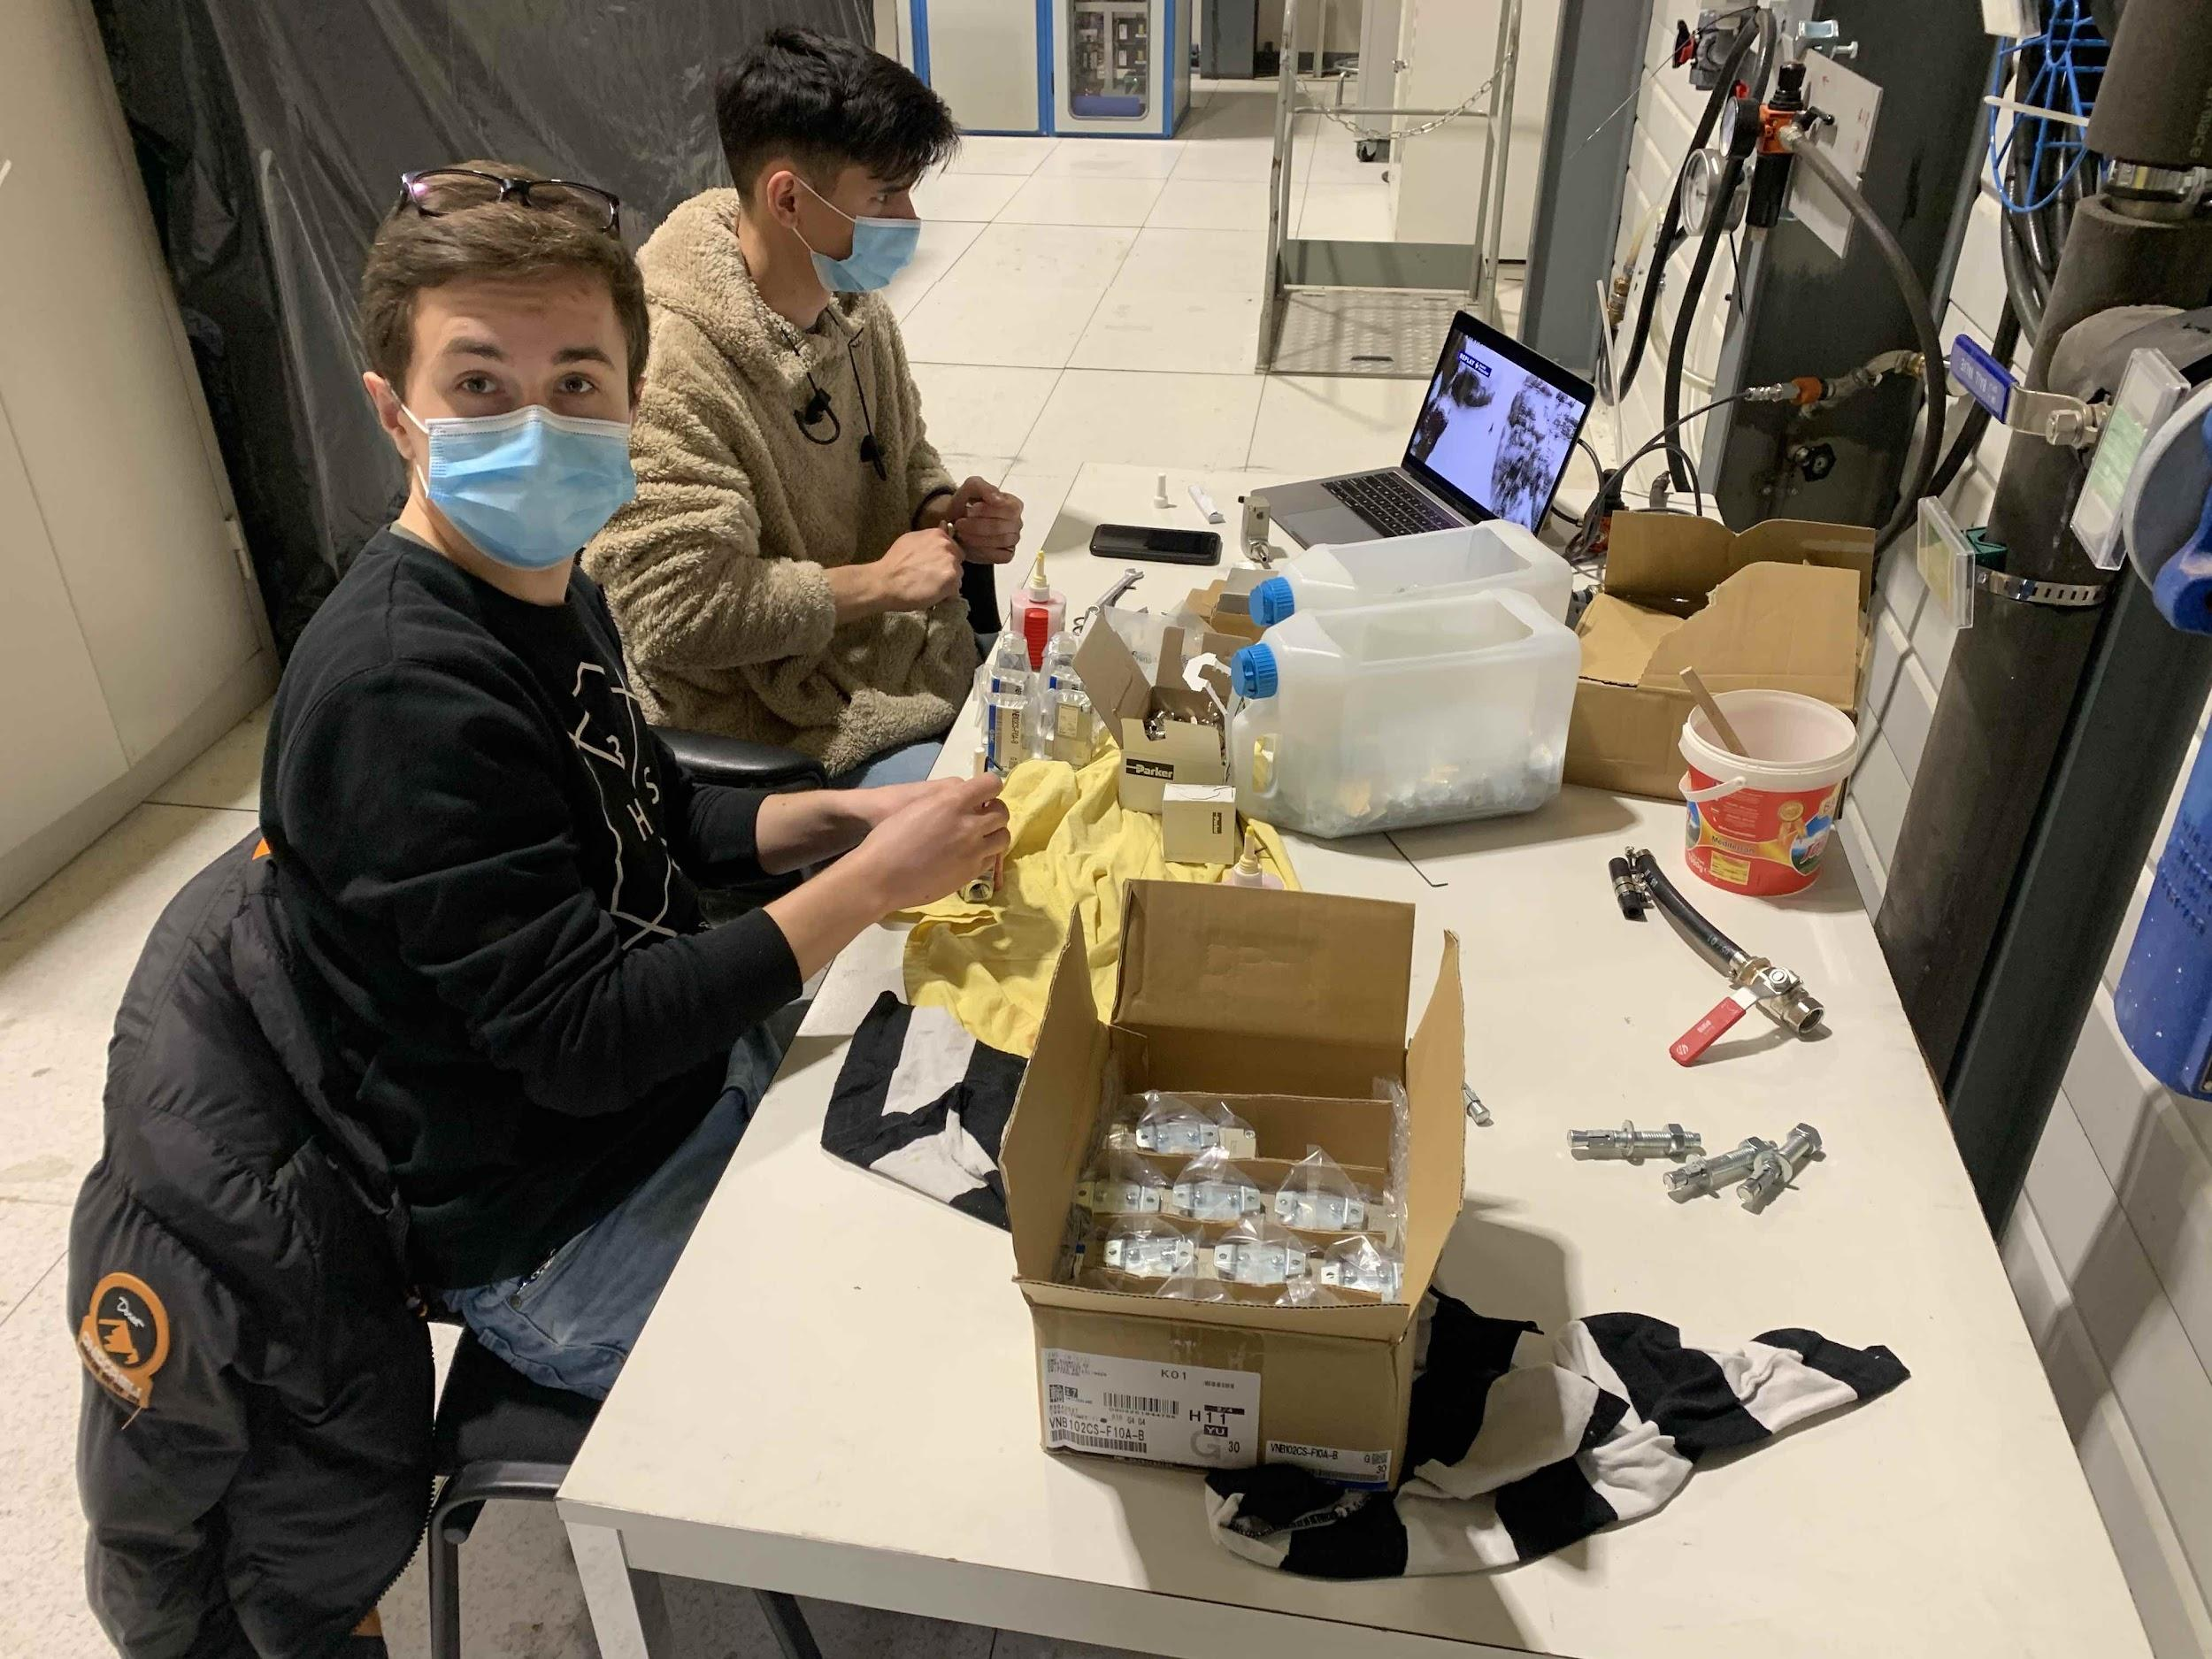
Preparing Valves
Working in SR1 to prepare valves
Assembly with non-magnetic and radiation-resistant parts
Testing for function and leakage
Preparation of mounting plates

Slide 16
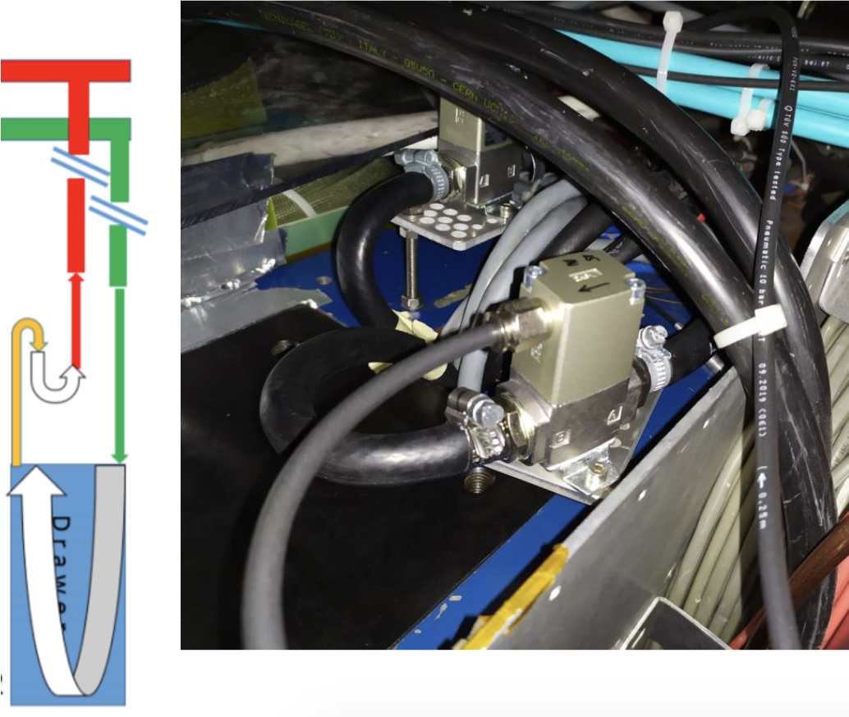
Isolation cooling valves - Mounting on drawers
Use various plate configurations to mount on LBA and LBC
Orientation and position is critical:
Avoid ATLAS location pins
Minimize hose bending radius
Ensure access to pipe connections
First pass on LBA and LBC (excluding difficult-to-access drawers) finished in March

Slide 17
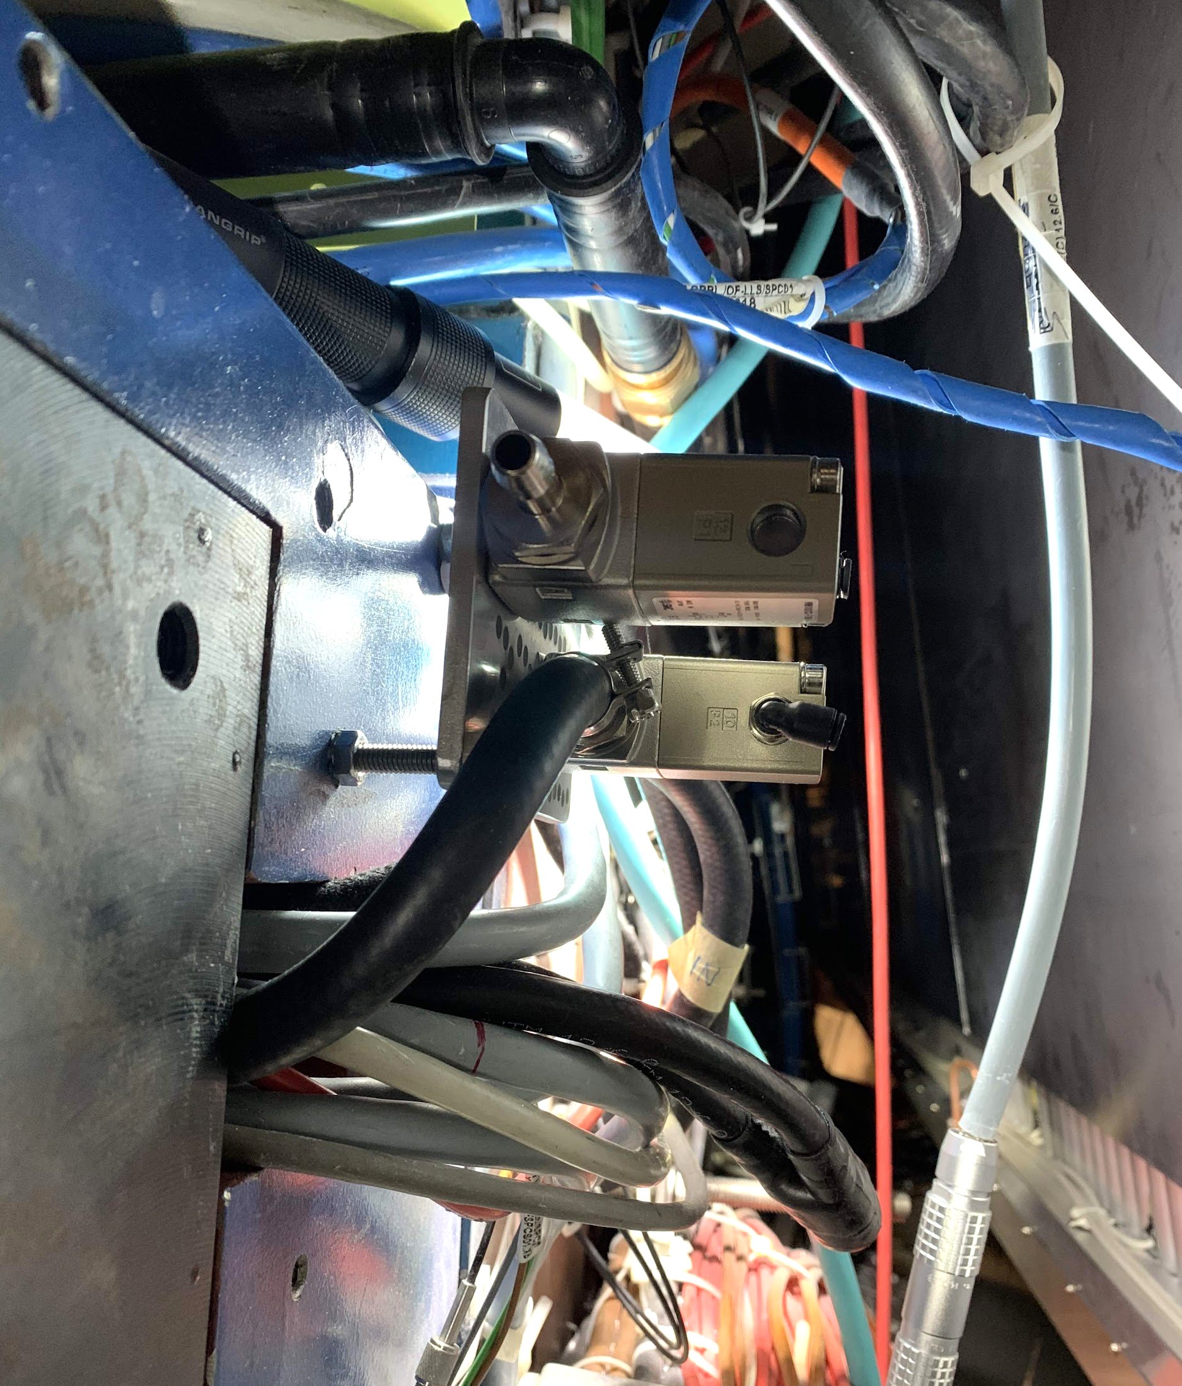
Isolation cooling valves - Hoses and pneumatics
Connecting valves often requires hose extensions
Open some drawers to install longer cooling hoses
Connect direction-specific pneumatic hoses (for opening/closing valves)
Completed for all mounted valves as of June

Slide 18
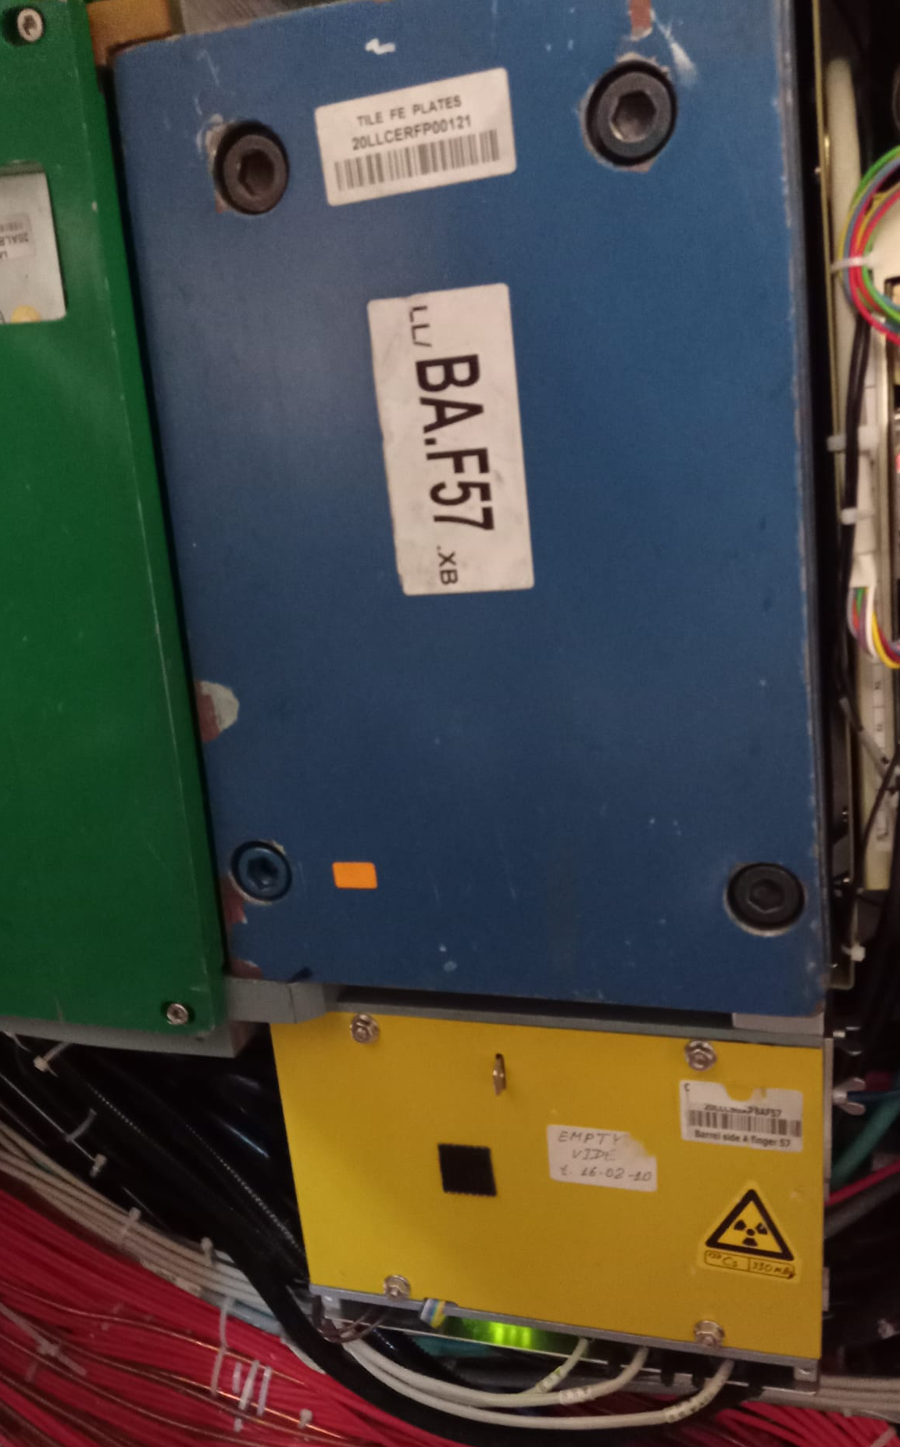
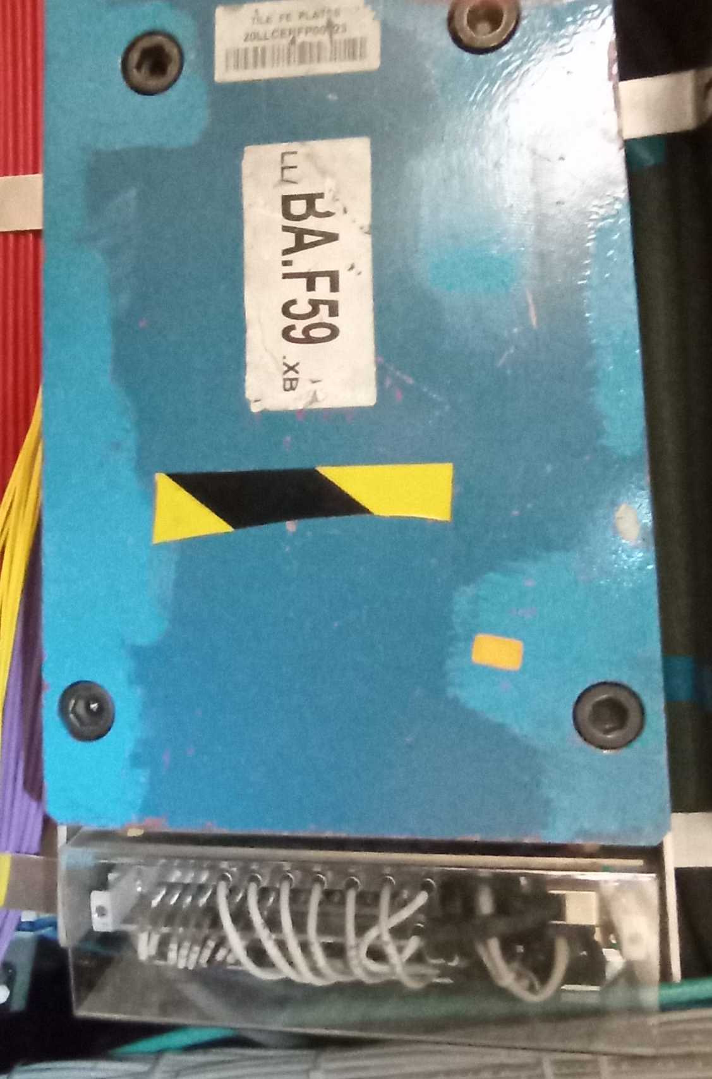
Isolation cooling valves - Typical challenges
Difficult access behind cesium electronics boxes and source garages
~10 drawers each on LBA and LBC
Working since late May to remove Cs obstructions and install valves
Other structural issues:
Metal plates (ATLAS structural frame)
Scaffolding access
Cables/wires blocking access

Slide 19
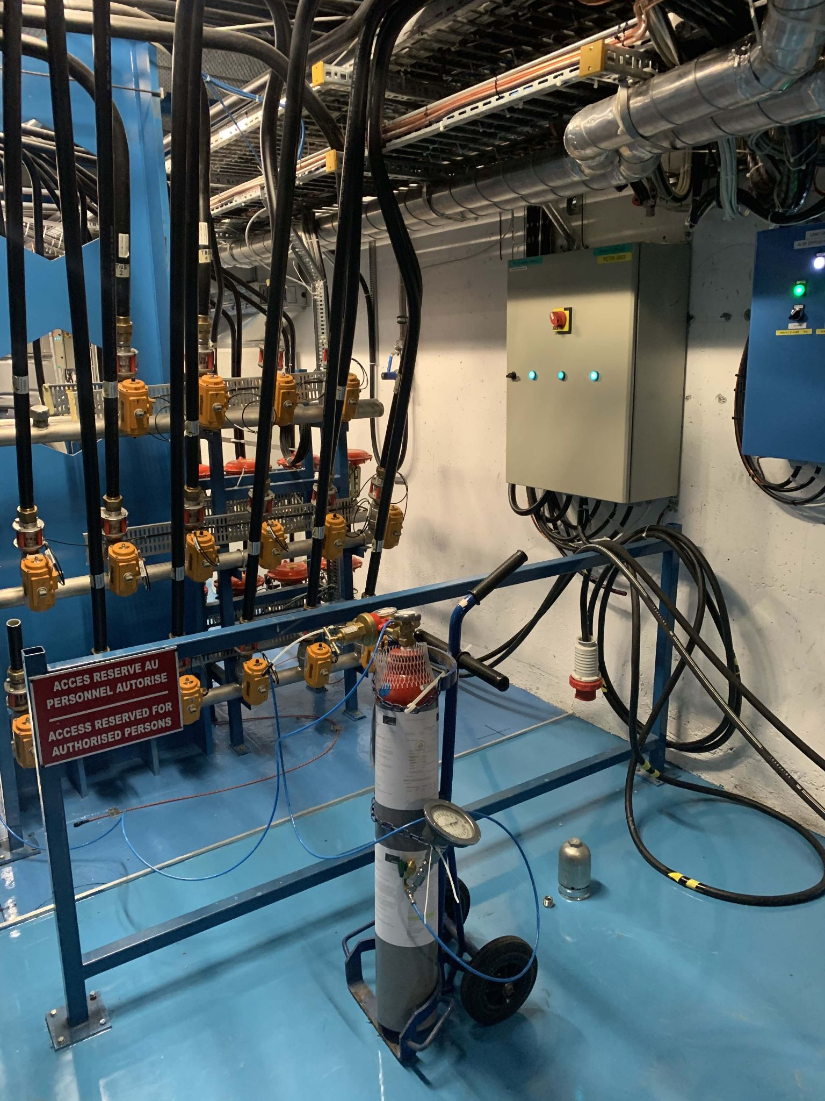
Isolation cooling valves - Addressing leaks
Working loop-by-loop, monitor PPV cycle time
Use clamps to isolate drawers when leak suspected
LBA 45 (early April): isolated & re-fitted valves
LBC 14 (April 13): bypassed 3/8 internal cooling loops
LBC loop #13 (late April): compressive gas test
Inject compressed N2 in loop return line
Use gas detector to identify leak source on finger side
Isolated to LBC 58 and 60; re-fitted valves
LBC 35 and 36 (May): isolated & re-fitted valves

Slide 20
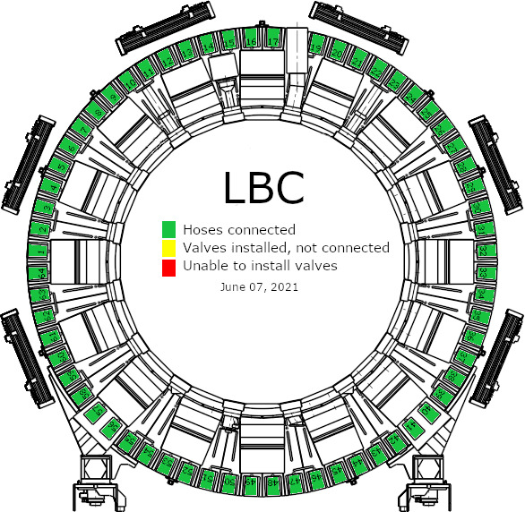
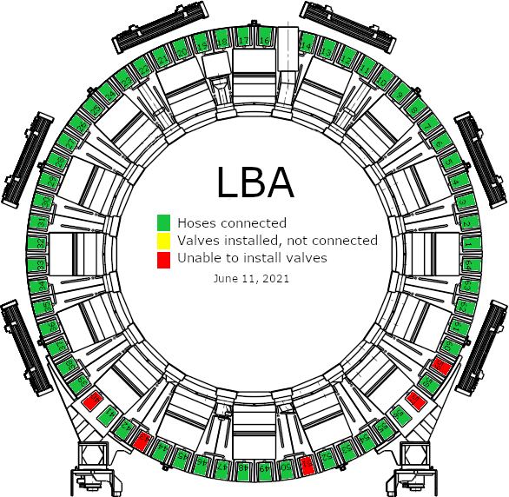
Isolation cooling valves - Current status
LBA 40, 43, 51, 57, and 59 are the only drawers remaining
LBA 40 and 57 may be inaccessible
Current delay - supply issues with clamps, scavenging where we can

Slide 21
Next steps for maintenance
Finish valve installation on LBA
Address remaining leaks:
Leak detected on
EBC: loops 20, 22, 23, 24
LBC: loops 15, 18
LBA: loops 7, 10
Currently, EBC partition is OFF. All others are ON.
Planning to fix loops this week
Continuing drawer maintenance

Slide 22
Charge Injection Systems (CIS)

Slide 23
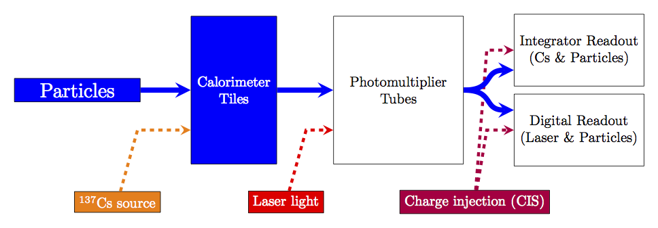
Overview of CIS
Calibration system for front-end readout electronics
Simulates physics signals by injecting a known charge and measuring the response
Characterizes each readout channel with a CIS constant

Slide 24
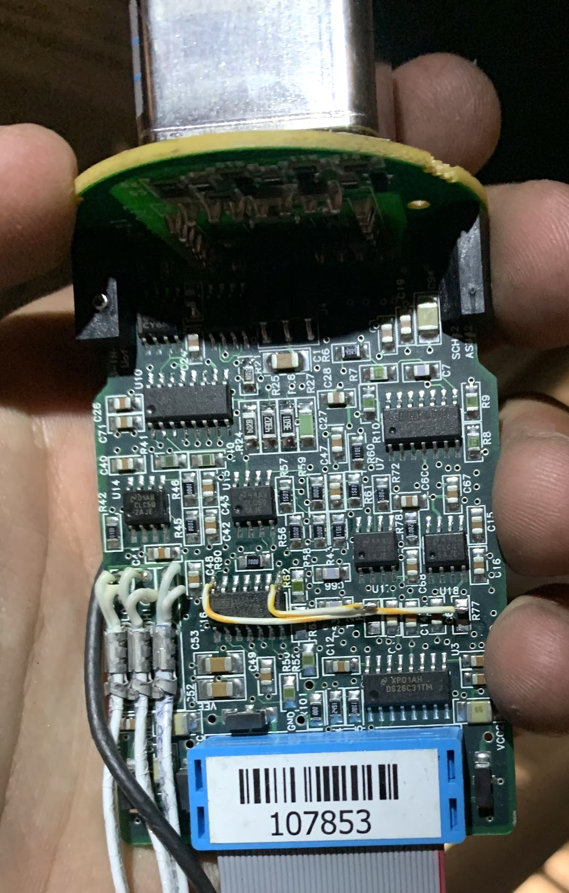
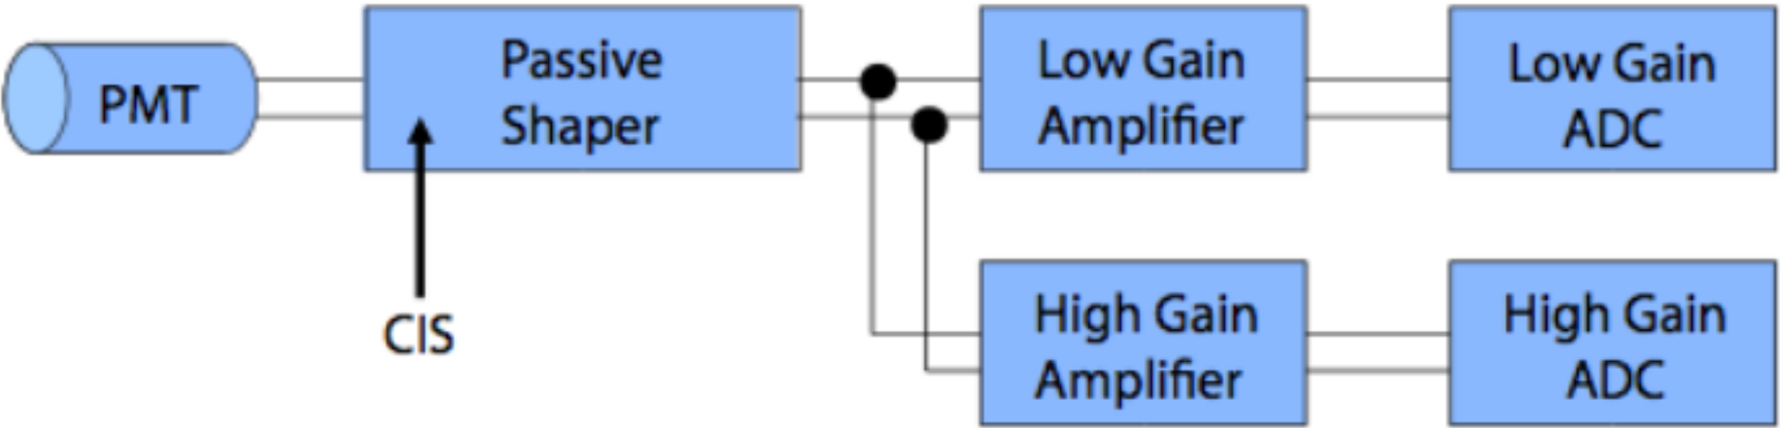
Charge injection
3in1 cards contain 5pF and 100pF capacitors
Capacitors vary charge of injected pulse
64x gain amplifiers shape and amplify pulse
Pass pulse to analog-to-digital converter (ADC)

Slide 25
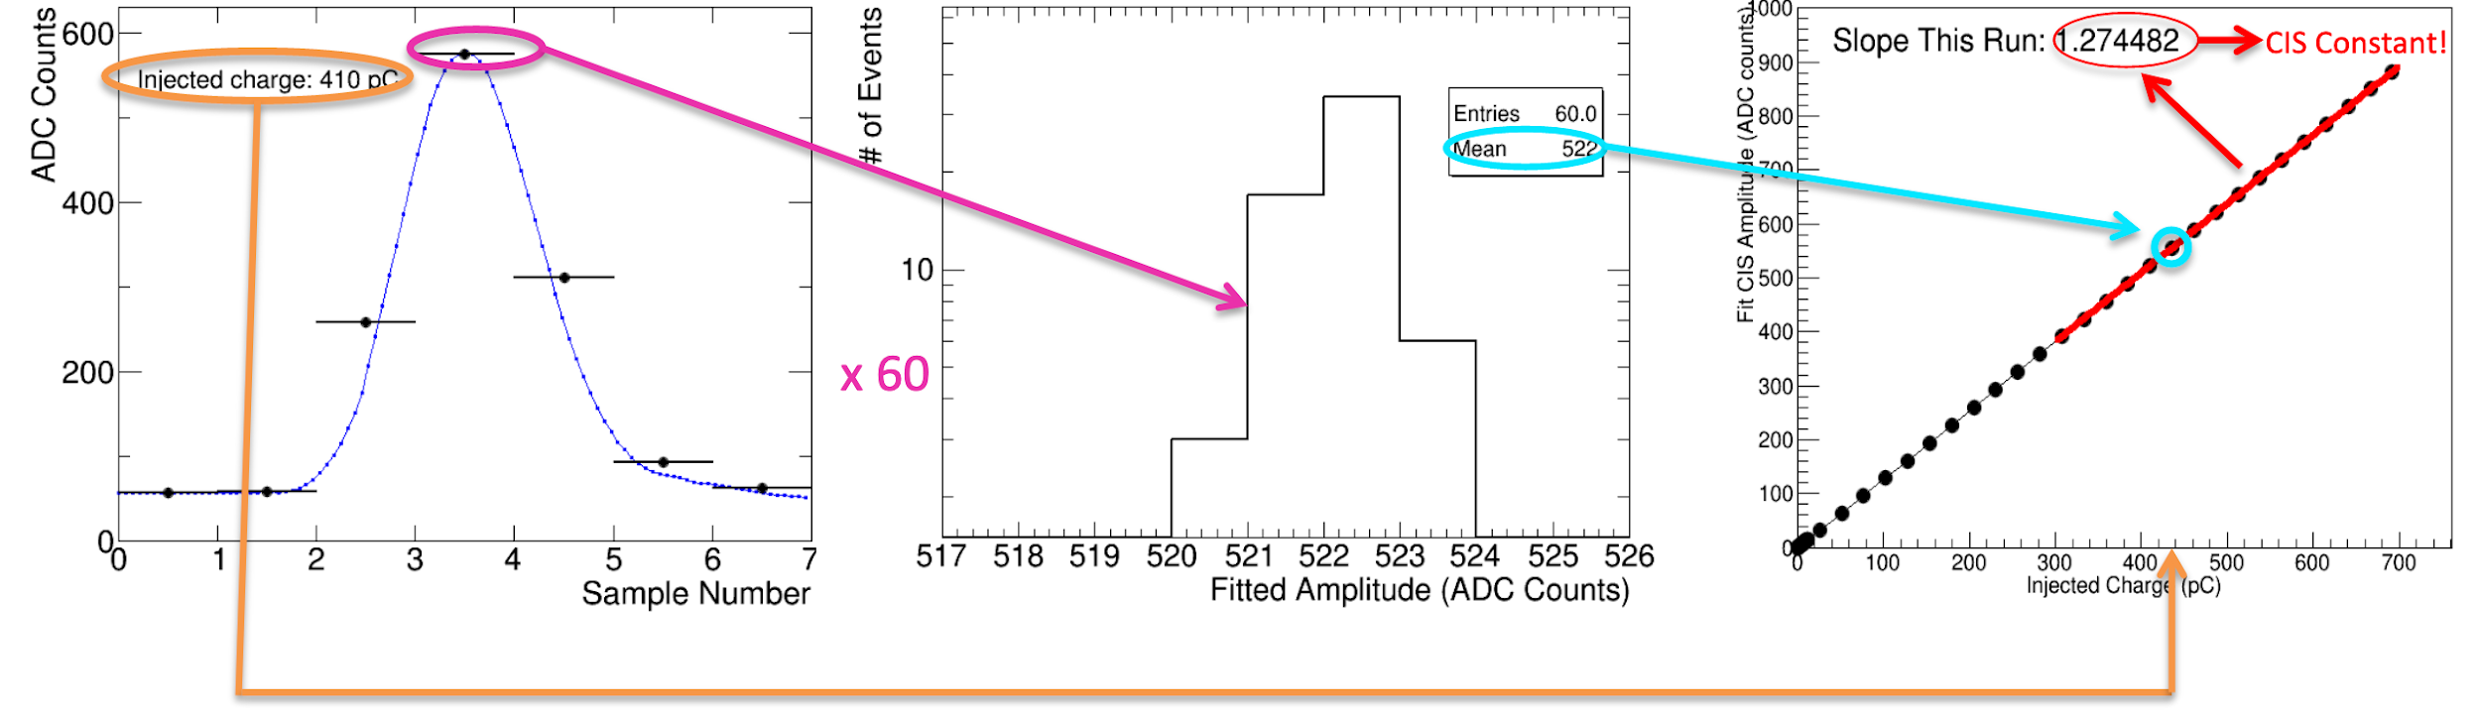
Calibration constants
60 injections sampled 7 times
15 steps varying phase between injection and sampling, 4 capacitor discharges each
Fit to a reference pulse
Mean amplitude measured for different charges
Amplitude (ADC counts) vs. charge (pC) relation gives CIS constant
For each of ~19700 channels

Slide 26
CIS Constant Recalibration
During LS2, CIS runs taken approximately twice per week
Verify maintenance and identify DQ problems
TileCal Unified Calibration Software (TUCS) used to track detector performance and diagnose problematic channels
Calculate new constants within given interval of validity
Excludes outliers and stable channels and identifies DQ flags
Update databases approximately monthly
Online and offline databases with UPD1 and UPD4 tags

Slide 27
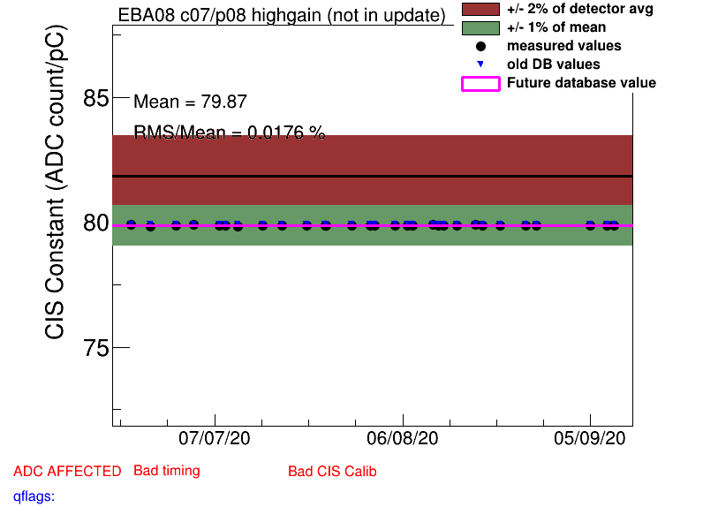
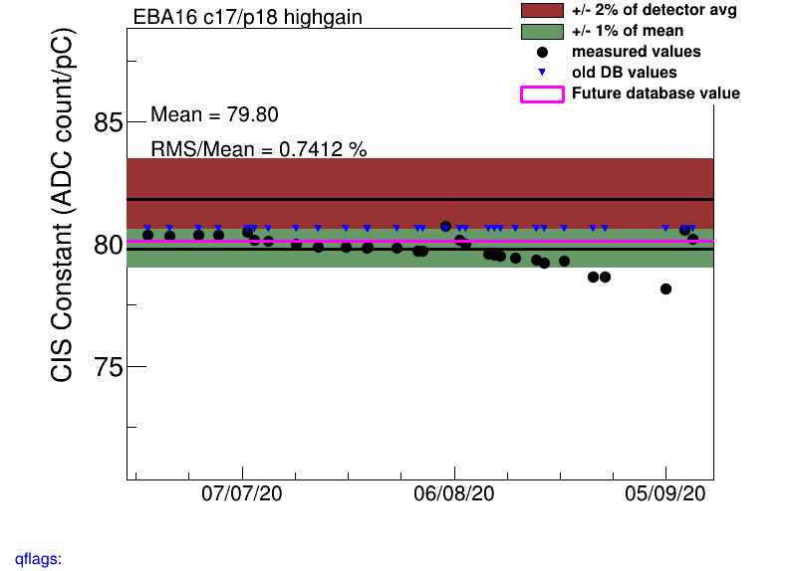
ADC recalibration example
Stable RMS, near detector average
Remove “Bad CIS” flag
High RMS, recently unstable
Add “Bad CIS” flag

Slide 28
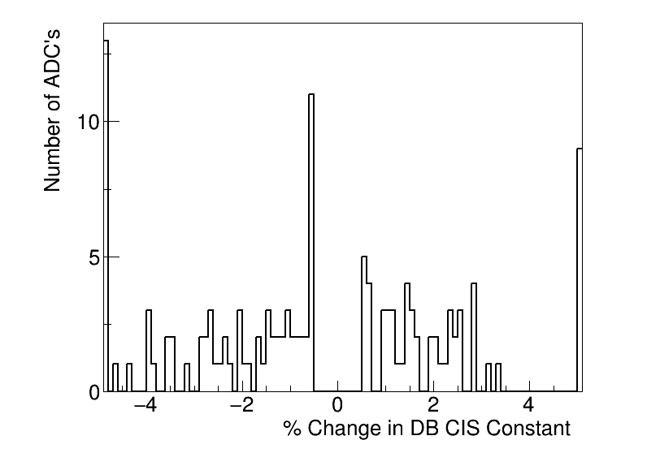
March CIS update (summary)
Updated on Mar. 28
CIS runs from 2/01-3/25
133 ADCs updated
62 good
22 >5% change
12 masked
59 affected

Slide 29
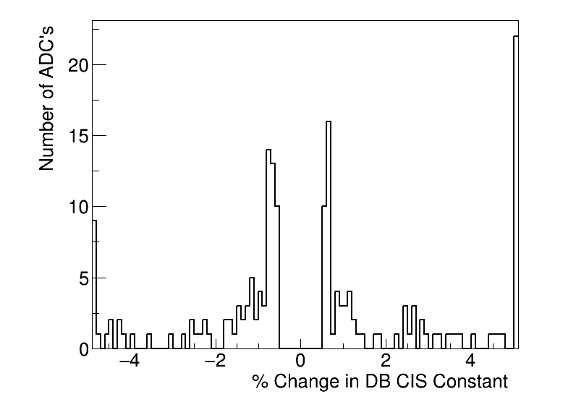
April CIS update (summary)
Updated on April 26
CIS runs from 3/28-4/23
182 ADCs updated
107 good
31 >5% change
13 masked
62 affected
Notes:
Negligible drift, few constants >5%

Slide 30
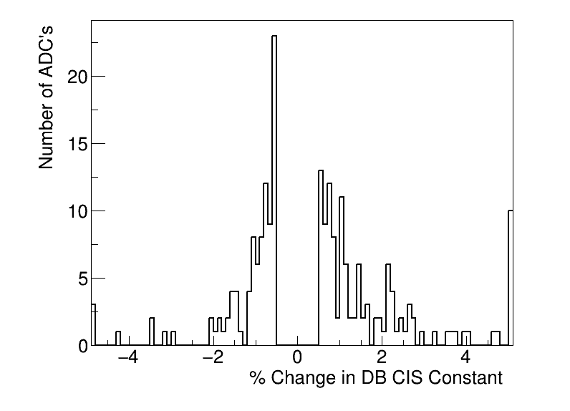
June CIS update (summary)
Updated on June 4
CIS runs from 4/27-6/01
214 ADCs updated
147 good
13 >5% change
10 masked
57 affected

Slide 31
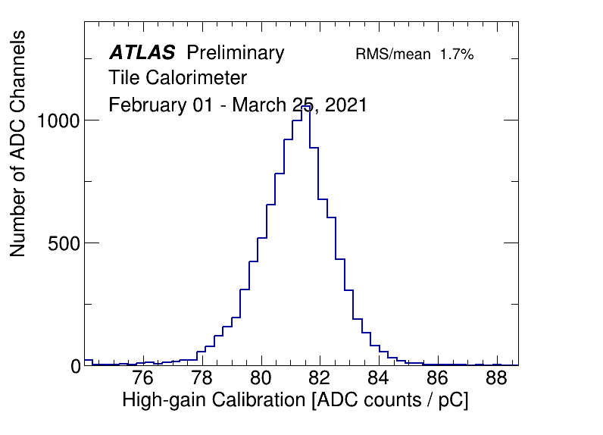
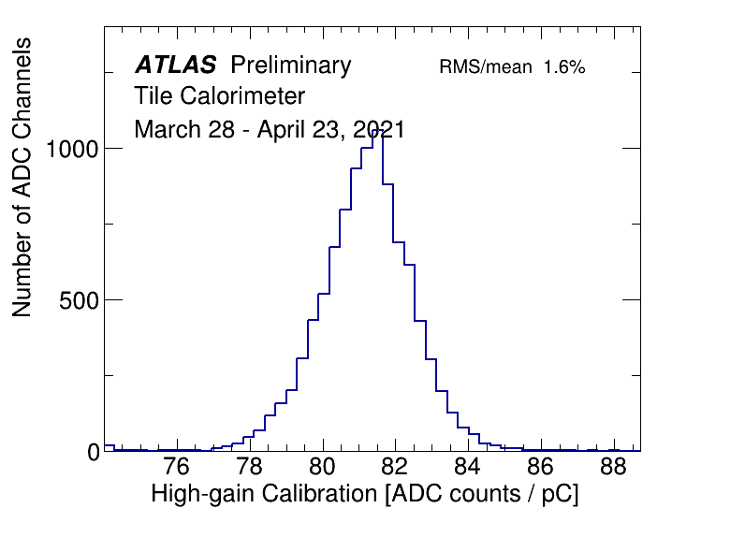
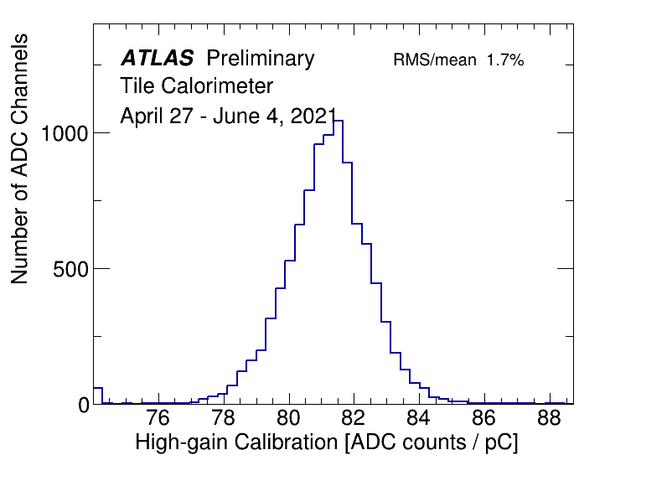
CIS constant distributions (high-gain)

Slide 32
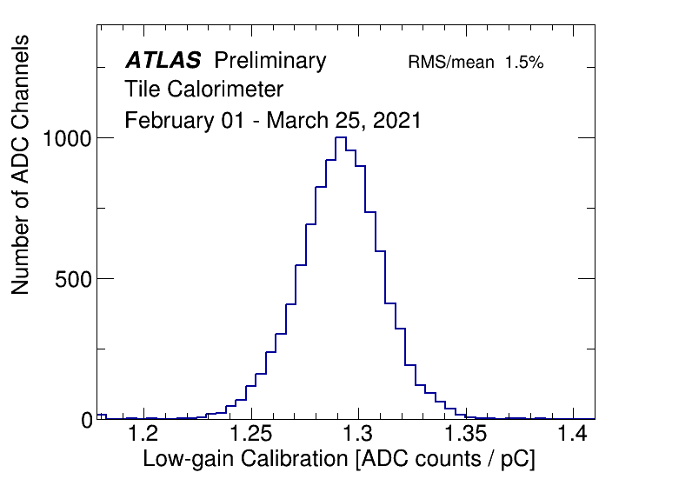
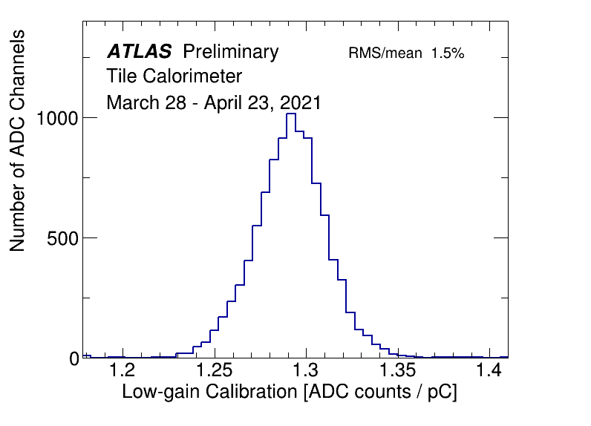
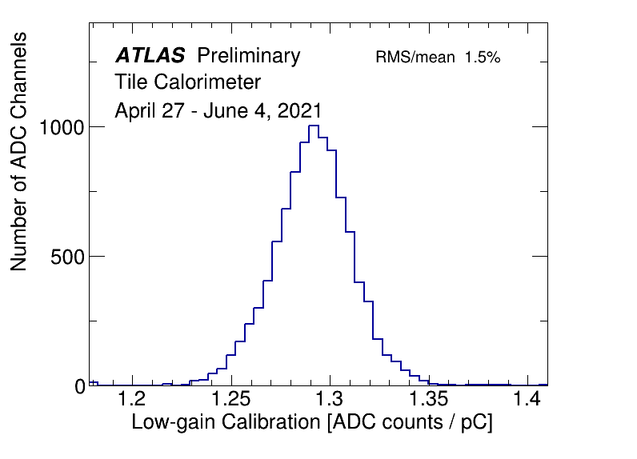
CIS constant distributions (low-gain)

Slide 33
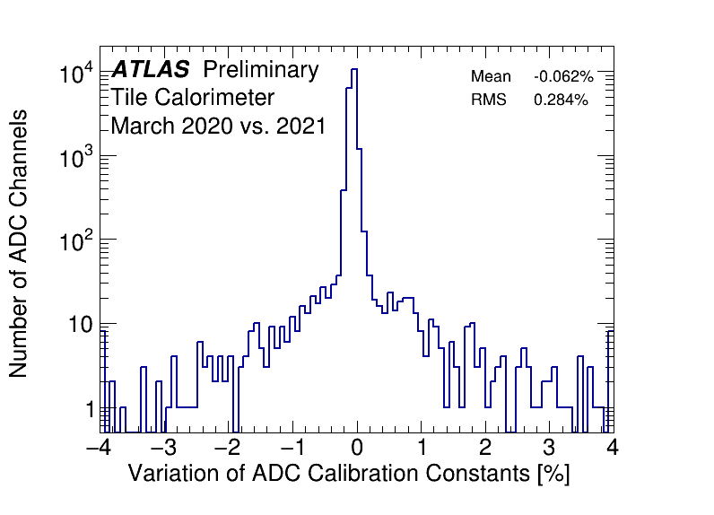
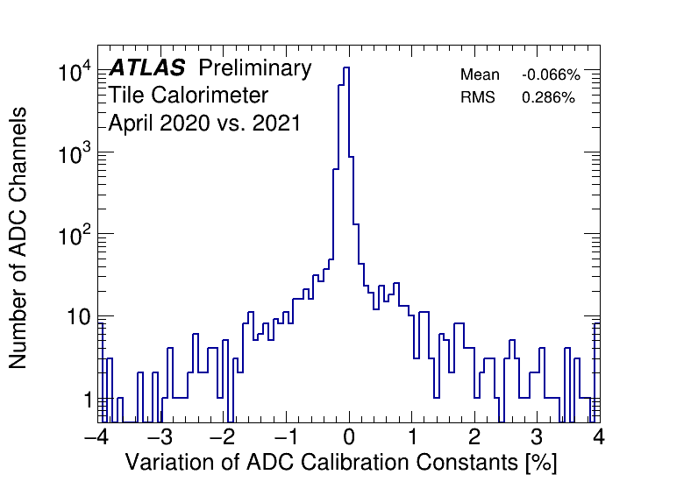
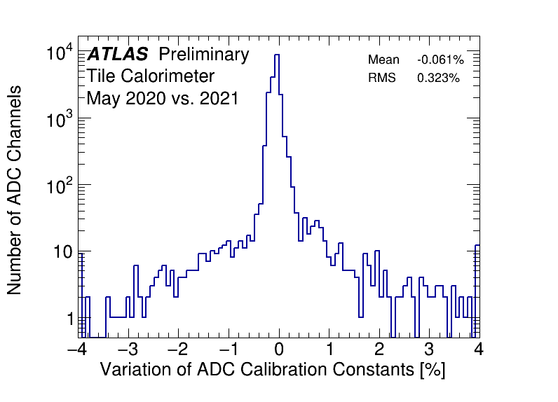
CIS constant stability

Slide 34
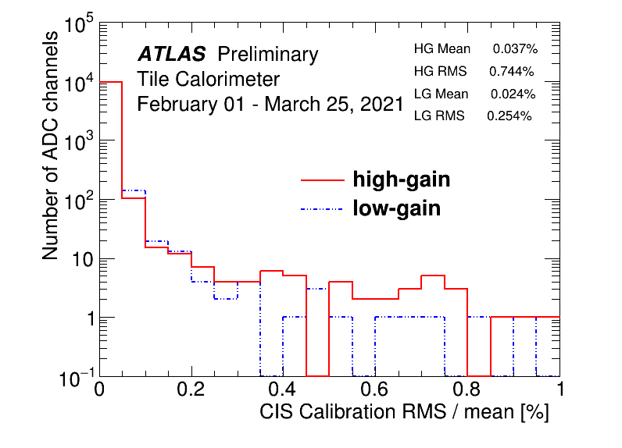
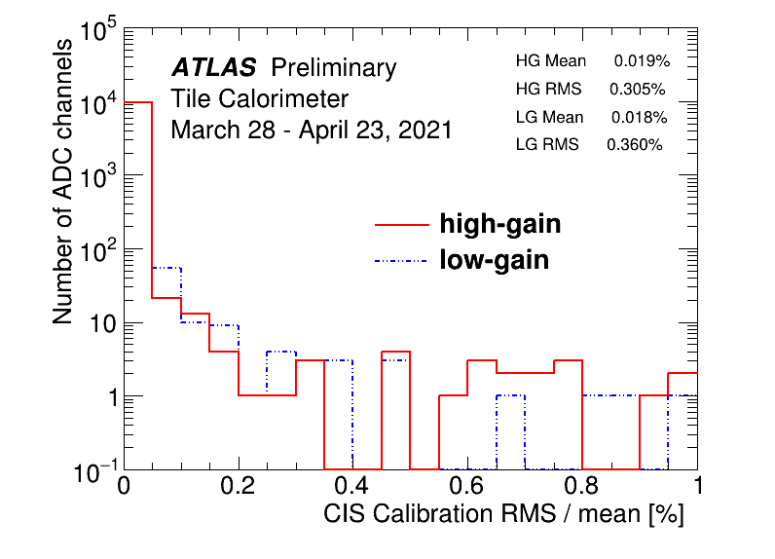
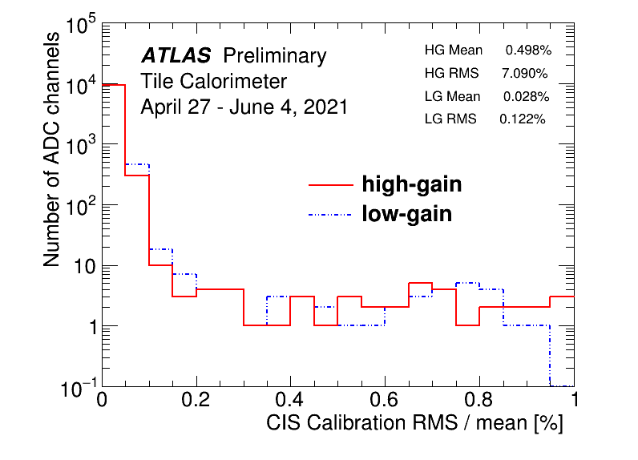
CIS constant RMS/mean
Notes:
ADCs with RMS/mean > 0.38% fail “Unstable” qflag.

Slide 35
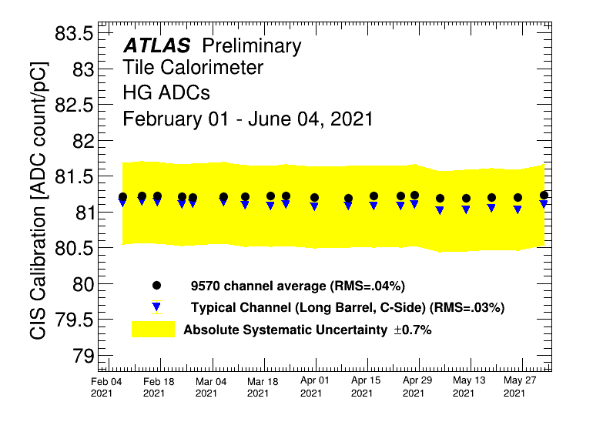
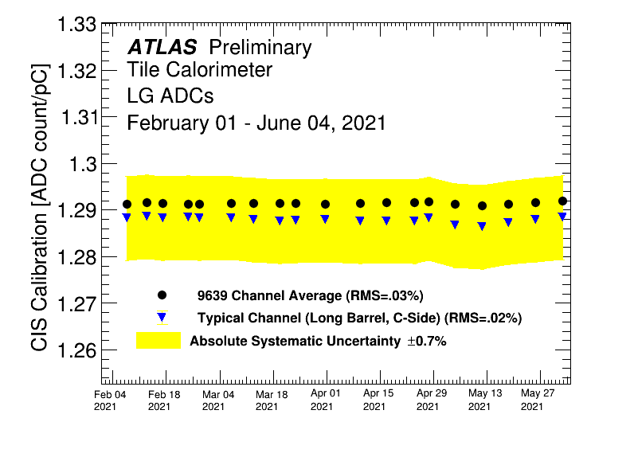
Detector stability

Slide 36
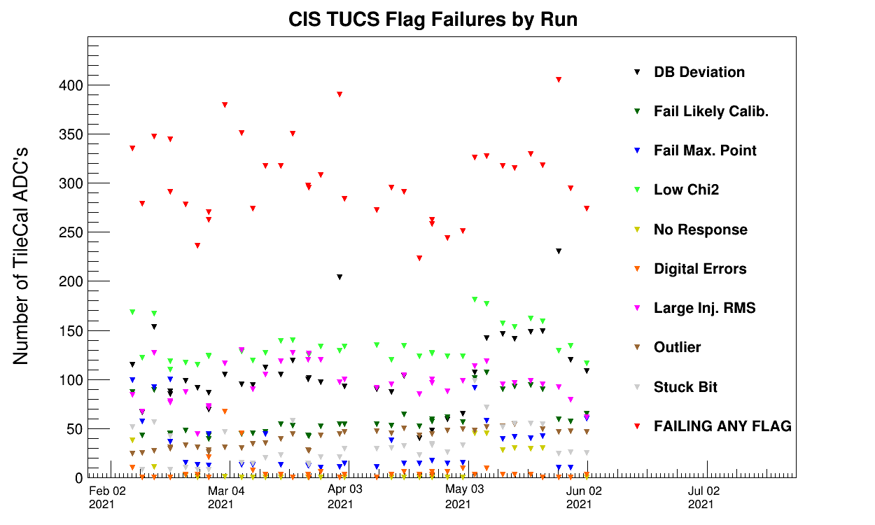
CIS TUCS Quality Flags

Slide 37
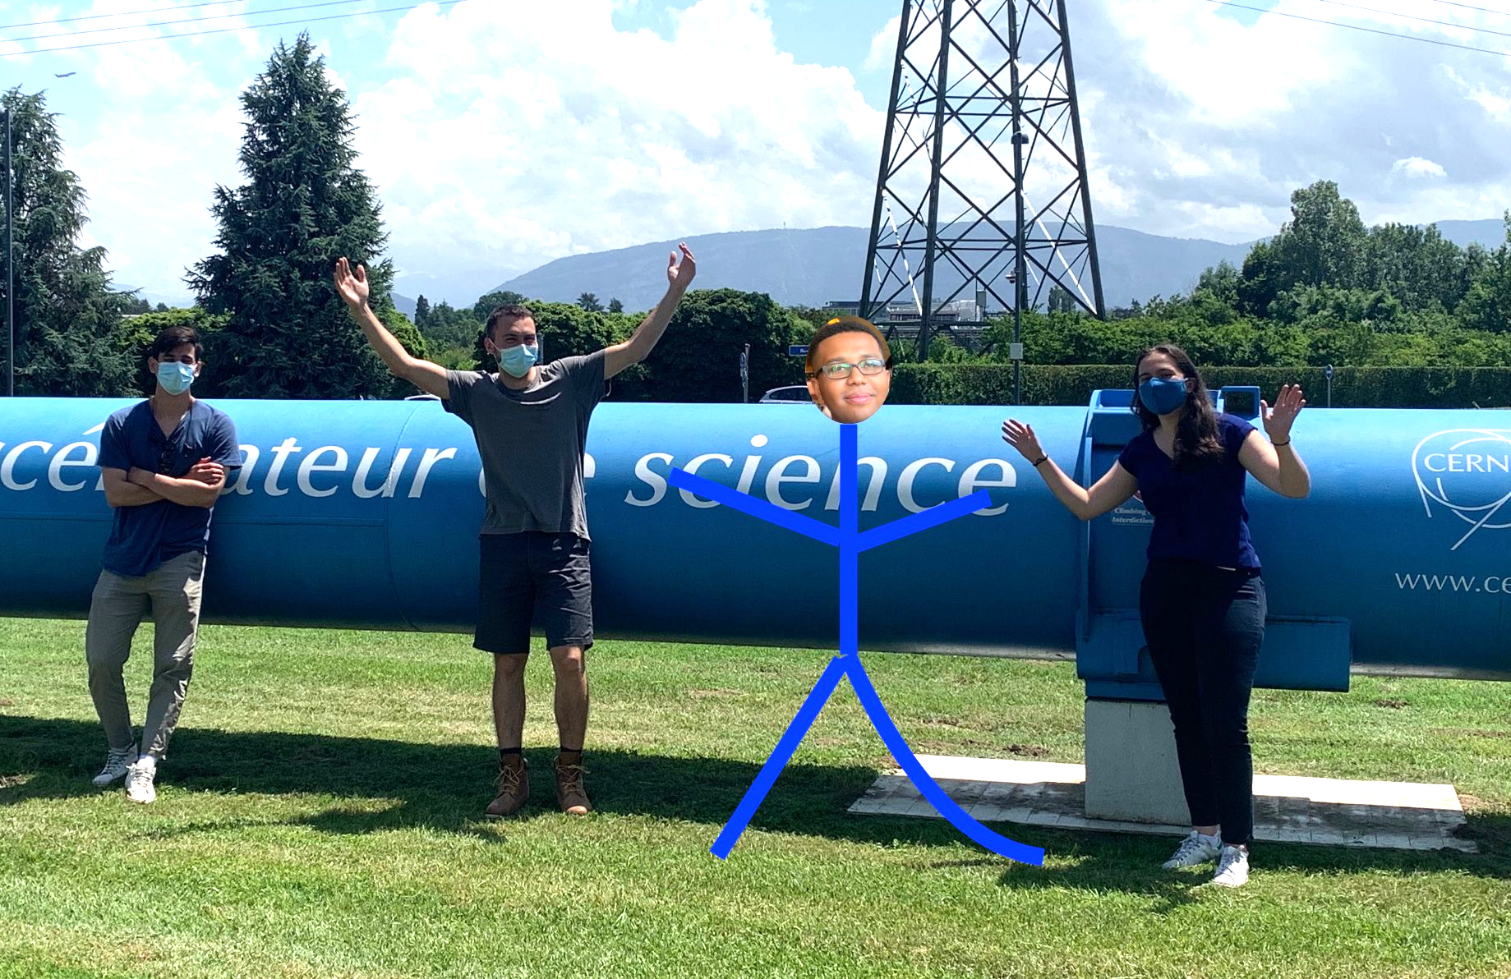
New CIS techs
Katie Hughes and Dawit Belayneh arriving this week
With Doug, guiding through on-boarding process and trainings
To do:
Update/revise twiki pages and guides
Push TUCS edits and smooth transition
Perform July CIS update with new techs
Begin valve installation on extended barrel with new techs
Elias leaving July 15; Mikel leaving July 30

Slide 38
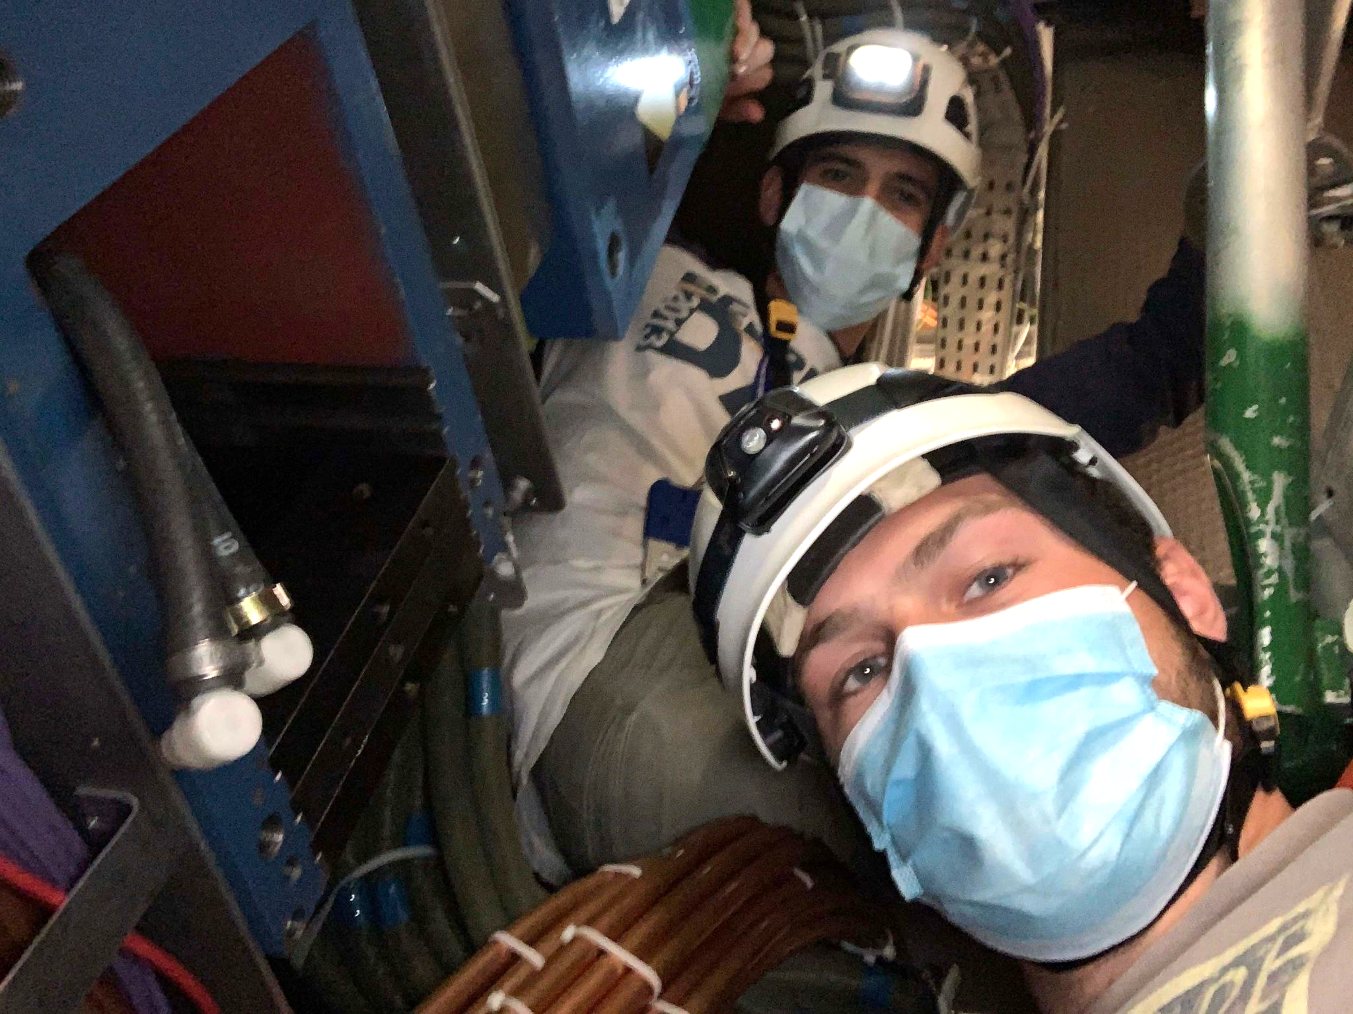
Thank you!

